Slide 1

Wireless Link I: Fundamental issues of Multiple Access
吳曉光博士 http://wmlab.csie.ncu.edu.tw/wms
無線網路多媒體系統
Wireless Multimedia System
(Topic 3)

Slide 2
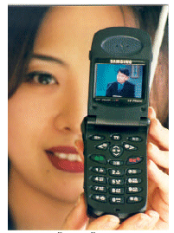

How to deal with Radio Propagation
IP backbone

Slide 3
Where are you from?

Slide 4
QoS and Multimedia Traffic Support
Application
OS, MiddleWare
RTP, TCP, UDP
Adaptive
Algorithm
by QoS
Requirement
RSVP
Mobility
Unpredictable
channel
by QoS
Information
IP, Mobile IP
Wireless Network Layer
Clustering(optional)
Data Link
MAC
Radio

Slide 5
Multiple Access & Modulation
Source
Coder
Multiplex
Multiple
Access
Channel
Coder
Modulator
Power
Amplifier
Source
Coder
Carrier f_{c}
“Limited b/w”
“Highly variable b/w”
“Random & Noisy”
“Spurious Disconnections”
Radio
Channel
Source
Coder
Demultiplex
Multiple
Access
Channel
Decoder
Demodulator
& Equalizer
RF
Filter
Source
Coder
Carrier f_{c}

Slide 6
Topic III Agenda
Wireless Link
  Deployment of “Pervasive Computing” and “Seamless Telecom services”
  Channel resource sharing in time, frequency, and code dimensions
  Spread Spectrum-direct sequence, frequency hopping, interference resistance
  Static techniques: TDMA, FDMA, CDMA
  Random access techniques: MACA, MACAW, 802.11 etc

Slide 7
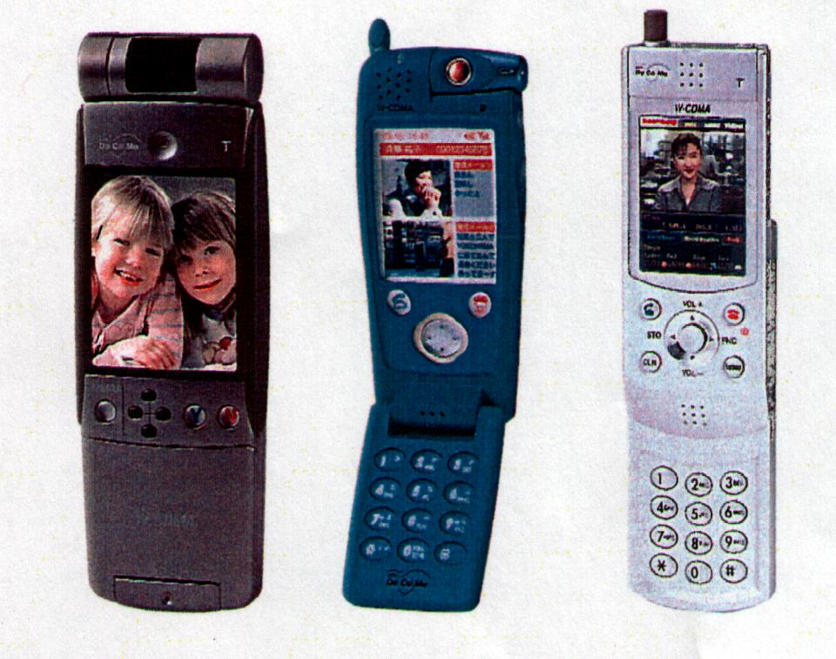

What kind of multiple access environments?

Slide 8
Reading list for This Lecture
Required Reading:
  (Bharghavan94) V. Bharghavan, A. Demers, S. Shenker, L. Zhang,”MACAW: A Medium Access Protocol for Wireless LANs, Proceedings of SIGCOMM’94
  (J.J.97) L. Fullmer and J.J. Garcia-Luna-Aceves, Solutions to Hidden Terminal Problems in Wireless Networks, Proceedings of SIGCOMM’97
  (Jing 2006) J. Zhu, B. Metzler, X. Guo, Y. Liu, “Adaptive CSMA for Scalable Network Capacity in High-Density WLAN: A Hardware Prototyping Aprroach”, Proceedings of Infocom 2006.
Further Reading
  (David 95) David D. Falconer, F. Adachi, and B. Gudmundson,”Time Division Multiple Access Methods for Wireless Personal Communications”,IEEE Communication Magazine January 1995
  (Vadu2000) Vaduvur Bharghavan,”Achieving MAC Layer Fairness in Wireless Packet Networks”. IEEE MobileCom2000
  (Songwu Lu2000) Haiyun Luo, Songwu Lu, Vaduvur Bharghavan,”A New Model for Packet Scheduling in Multihop Wireless Networks”. IEEE MobileCom2000
  (J.J.2001) L. Bao A New Approach to Channel Access Scheduling for Ad hoc Networks, IEEE MobileCom2001
  (Alex2001) A. Woo, David E. Culler,”A Transmission Control Scheme for Media Access in Sensor Networks”, IEEE MobileCom2001
  (Gavin2001) G. Holland, N. Vaidya, P. Bahl,”A Rate-Adaptive MAC Protocol for Multi-Hop Wireless Network, IEEE MobileCom2001

Slide 9

Pervasive Computing Projects
Packet Oriented -> Multimedia Traffic

Slide 10
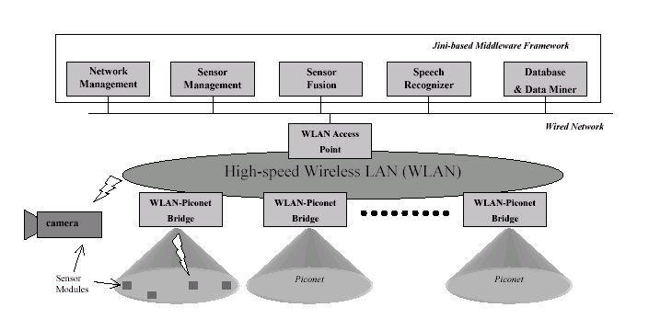
Smart Kindergarten (UCLA)
Notes:
Sensor-based Wireless Networks for Smart Developmental Problem-Solving
Environments
Person to person, person to computer
Embeded networking, wireless and computing capability into other objects.
Micro-sensors to react to external stimuli
Wireless networking and computing engines for tetherless communication with
compute servers and other networked embeded objects.
A single chip: integrate processor, memory, radio and sensor millimeters, a few
Dollars, a few milliwatts

Slide 11
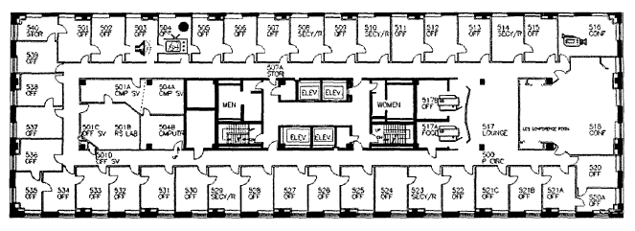
Cricket Location-Support System (MIT)
Beacon broadcast <-> Listeners
Cricket Location-support system
Notes:
Cricket Location Support System for in-building, mobile, location dependent
Applications. By listening beacons spread throughout the buildings.
Cricket device is less than 10 U.S. Dollars
Context aware, location-dependent (MIT Project OxygenMIT)

Slide 12
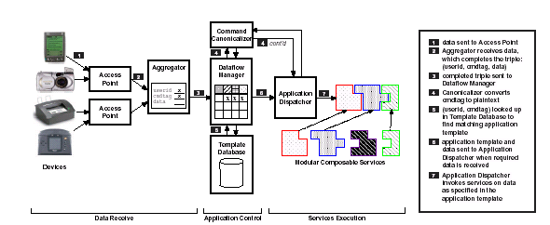
Making Computer Disappear (Stanford)
ADS (Appliance Data Services)

Slide 13
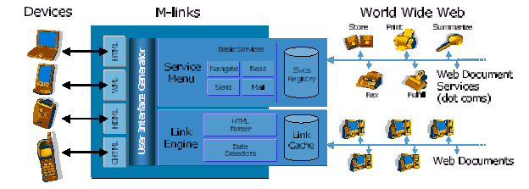

M-Links (Xerox)

Slide 14
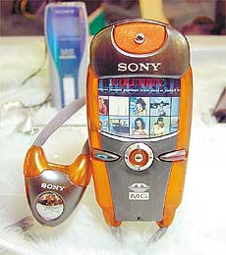
Seamless Telecom Deployments
Circuit Services-> Data Services -> Multimedia

Slide 15
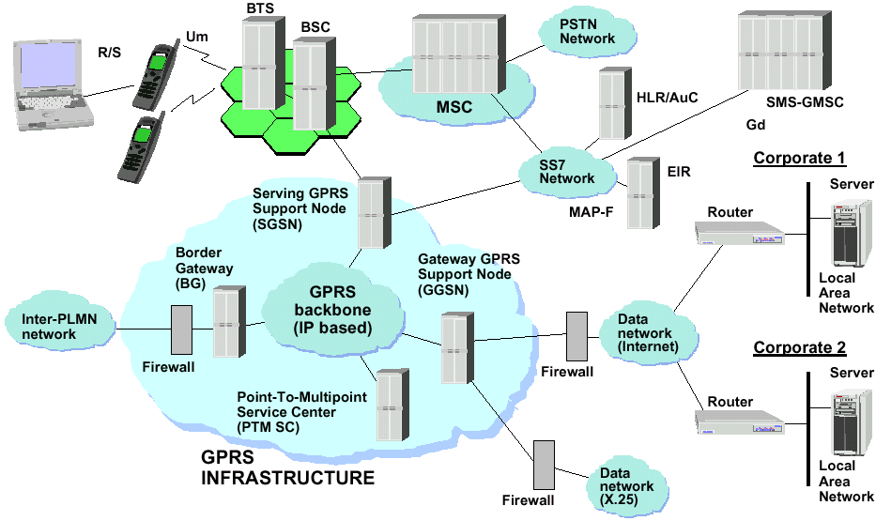
2.5 G & 3 G
Packet Radio
Packet Backbone
System Integration
Multimedia Services
Mobile Computing

Slide 16
Wireless Networking Technology
Telecom & Datacom
Circuit & Packet

Slide 17
MAC Design Issues
What kind of Resource we have?
How much you need and how often and how regular you need?
How often you will initial request?
How much traffic you could afford?
How much “Promise” you could provide?
How fair you are going to be?
Control or “Let it be”?
Power Saving Issues?
Complexity?

Slide 18

Circuit Switch (Static Technique)
Cellular System
  AMPS
  GSM
Voice System
  Continue Traffic
Circuit Set up
  Reserve A trunk

Slide 19



HOW about Data

Slide 20

Packet Radio
Packet Nature
  If we could deliver information by packet
  Bursty Type of Traffic
  Packet Size

Slide 21
Multiple Access
Fundamental Problem
  How to share the Time-Frequency Space among multiple co-located transmitters?
Frequency
Shared Time-Frequency Subspace
Time
CDMA approach

Slide 22
Cellular versus Ad hoc Models
WLAN
Peer-to-Peer
(ad hoc network-
Fully-connected vs multihop
Base-station
(infrastructure-centralized)

Slide 23
Approaches to Wireless Multiple Access
Sharing of Time-Frequency Space
Slotted-time vs Non-Slotted Time
Demand-based Assignment
Static (Fixed) Assignment
e.g. Time Division &
Frequency Division
“Connection Oriented”
Contention-based
Conflict-free
e.g. Token-passing &
Polling
Random Access
e.g. ALOHA, PRMA
Carrier-Sensing
Scheduled Access
e.g. DQRUM
“Packet Oriented
Controlled Random Access

Slide 24
Frequency Division & Time Division Duplexing
Frequency Division Duplexing (FDD)
  Two distinct frequency at the same time for the two directions
  Frequency separation must be coordinated to allow cheap RF technology
  Coodination with out-of-band users between the two bands
  Geared towards providing individual frequencies for each user
Time Division Duplexing (TDD)
  Two distinct sets of time slots on the same frequency for the two directions
  Time latency because only quasi-duplex
  No need for RF duplexer
Forward
Channel
Reverse
Channel
frequency
Forward
Channel
Reverse
Channel
Time

Slide 25
Frequency Division Multiple Access (FDMA)
Assign different frequency bands to individual users or circuits
  Frequency band (“channel”) assigned on demand to users who request service
  No sharing of the frequency bands: idle if not used
  Usually available spectrum divided into number of “narrowband” channels
    Symbol time >> average delay spread, little or no equalization required
  Continuous transmission implies no framing or synchronization bits needed
  Tight RF filtering to minimize adjacent band interference
  Costly bandpass filers at basestation to eliminate spurious radiation
  Usually combined with FDD for duplexing
Frequency
f₁¹
f₂
f₁¹
f₂
f₁
f₂¹
f₁

Slide 26
Example-AMPS Cellular System
User FDMA/FDD
  A channel is a pair of frequency duplexed simplex channels
  Each simple channel is 30 KHz
  Simple channels are separated by 45 MHz (allow cheap RF duplexers)
  Forward link 869-894 MHz, reverse link 824-849 MHz
  Two carriers per market share the channels
Number of supported channels in AMPS
Problem: set of active users is not fixed
  How is the FDMA/FDD allocated to a user who becomes active?
    Static multiple access is not a complete solution .. Need a separate signalling channel with “demand-access”.
    Pure FDMA is basically “dead” in the digital world

Slide 27

Time Division Multiple Access (TDMA)
Multiple user share frequency band via cyclically repeating “time slots”
  “channel”==particular time slot reoccurring every frame of N slots
  Transmission for any user is non-continuous: buffer-and-burst digital data & modulation needed, lower battery consumption
  Adaptive equalization is usually needed due to high symbol rate
  Larger overhead-synchronization bits for each data burst, guard bits for variations in propagation delay and delay spread
  Usually combined with either TDD or FDD for duplexing
    TDMA/TDD: half the slots in a frame used for uplink, half downlink
    TDMA/FDD: identical frames, with skew (why), on two frequencies
Frequency
Slot 2
Slot 1
Slot 6
Slot 5

Slide 28
TDMA
More features
  Simply mobility & link control.. Snoop for other BSs during idle slots
  Pulsating power envelop:interference with devices such as hearing aids
Possible enhancements to basic TDMA to integrate non-voice services
  Different # of slots per frame to different users (variable bit rate)
  Dynamically reassign time slots for “bandwidth on demand”

Slide 29
Packet Radio
Packet Nature
  If we could deliver information by packet
  Bursty Type of Traffic
  Packet Size

Slide 30
CSMA with Collision Detection/Avoidance
CSMA/CD:enhancement to slotted or unslotted CSMA schemes
Node monitors its own transmission
  If collision detected, transmission is aborted without waiting for a NACK backoff and re-transmission procedure started
  A jamming signal may be sent to get everybody else to abort too
Problem: does not work with RF wireless
  Cannot easily sense the channel while transmitting
    MH’s signal will dominate, need different receiving and transmitting antenna patterns
But, does work well with infrared wireless.. Directional receivers
Wireless networks stick with ACK/NACK approach
  Popular called CSMA/CA
  802.11

Slide 31
CSMA with Collision Detection/Avoidance
CSMA/CD:enhancement to slotted or unslotted CSMA schemes
Node monitors its own transmission
  If collision detected, transmission is aborted without waiting for a NACK backoff and re-transmission procedure started
  A jamming signal may be sent to get everybody else to abort too
Problem: does not work with RF wireless
  Cannot easily sense the channel while transmitting
    MH’s signal will dominate, need different receiving and transmitting antenna patterns
But, does work well with infrared wireless.. Directional receivers
Wireless networks stick with ACK/NACK approach
  Popular called CSMA/CA
  802.11

Slide 32
RANDOM Access
Give everybody freedom

Slide 33



Hawaii Story
University of Hawaii
ALOHA
  Hello and Goodbye

Slide 34


ALOHA System
If you want, transmit
If no acks
  wait a random time
  transmit the same packet again
Problem ?
  Collision ?
  A lot of Users ?

Slide 35
Pure ALOHA Throughput
20 %
Traffic Load

Slide 36
Slotted ALOHA Throughput
40 %
20 %
Traffic Load

Slide 37
Slotted ALOHA
Maybe We could do
some arrangement ?

Slide 38
QoS & Delay
20 %
Traffic Load
DELAY

Slide 39
Whenever Users are many
No one will succeed
Collides all the time

Slide 40
Reason
No one really listen to other people
No one really cares

Slide 41
CSMA
Most LANs use CSMA
Carrier Sense
  CSMA/CA: Collision Avoidance
  CSMA/CD: Collision Detection

Slide 42
CSMA
Check if carrier is ok
if the channel is free
  transmit
Otherwise, if the channel is busy
  wait a random time and try again
  Back of a random time

Slide 43
CSMA
60 %
CSMA
20 %
Slotted ALOHA
pure ALOHA
Traffic Load

Slide 44
Multimedia support?
Integrated CSMA/TDMA MAC Protocol
Time Bounded / Async
Hybrid of reservation and Random Access
A frame is segmented into:
  Two reservation intervals for isochronous traffic
  One interval for random access traffic
Async
Contention Free
Service
Contention
Service
MAC
PCF Optional
DCF
(CSMA/CA )
PHY
CFP repetition interval
Contention Free Burst
PIFS
D1
Contention Period
D2
D3
D4
Busy Medium
U1
U2
No Up
U4
CF_End
Dx = AP-Frame
SIFS
Ux = Station-Frame
Reset NAV
NAV
Min Contention Period

Slide 45
Can Support AP or Ad Hoc
AP (Access Point)
Ad HOC
  Coordination Function will be distributed among all of the nodes of the ad hoc network

Slide 46
Challenge of Wireless Network
Does “listen before you talk “ work ?

Slide 47
Hidden Terminal
Due to transmission range

Slide 48
Carrier Sense Multiple Access (CSMA)
To avoid collision, sender senses the carrier before transmission. But collision occurs at the receiver not transmitter.
Hidden Terminal -
Exposed Terminal-
A
B
C
A
B
C
D

Slide 49
Multiple Access Collision Avoidance (MACA)
RTS
A
CTS
B
DATA
Request-To-Send (RTS) packet: A to B.
Clear-To-Send (CTS) packet: B to A.
Node overhearing RTS will defer until A receive CTS.
Node overhearing CTS will defer until B receive data.
What do the above two features achieve (Hidden Terminal and Exposed Terminal)?

Slide 50
Hidden Terminal Problem Still Exists (1)
Data packet still might suffer collision
RTS
CTS
DATA
RTS
RTS
B
C
A

Slide 51
Hidden Terminal Problem Still Exists (2)
Data packet still might suffer collision
DATA
RTS
CTS
CTS
RTS
DATA
RTS
B
C
E
A

Slide 52
Exposed Terminal Problem Still Exists
Node C can not receive CTS
RTS
DATA
CTS
RTS
CTS
B
A
D
C

Slide 53
MACAW
Features
Backoff algorithm.
Multiple Stream model.
Basic Message Exchange
  ACK
  DS
  RRTS

Slide 54
Backoff Algorithm
The algorithm used in MACA: Binary Exponential Backoff (BEB).
  Maintains a Backoff counter (BO)
  BO is doubled after every collision
  Reduced to minimal BO after every successful RTS-CTS exchange.
  Sender waits for an interval chosen randomly between 1 and BO.
  F_{inc}(x) = MIN [ 2x, BO_{max}]
  F_{dec}(x) = BO_{min}
Results in unfair sharing of bandwidth.

Slide 55
Modifications used in MACAW
After every successful transmission all pads are made to have the same BO. (What is the problem with this?).
Gentler adjustment (MILD):
  Upon collision F_{inc}(x) = MIN [ 1.5x, BO_{max}].
  Upon success F_{dec}(x) = MAX [ x-1, BO_{min}].

Slide 56
RTS/CTS/DATA/ACK
RTS
CTS
DATA
ACK

Slide 57
Problems in Contention-based Wireless Multiple Access
Near-Far effect-characterized by capture ratio of the receiver
  Strongest (near by) transmitter can capture the intended receiver
  Weaker (far away) transmitters get ignored by the receiver
  Depends on receiver and modulation used
  Fairness terminal problem
Hidden terminal problem
  Terminal “hidden” from the transmitter may disrupt the receiver
  Makes carrier sensing ineffective
  A cannot detect collisions at B due to transmission from C
  Solve by using RTS/CTS control frame to reserve medium

Slide 58
More on RTS/CTS
RTS/CTS serve to “reserve” the medium
  RTS contains length of proposed transmission
  CTS also contains length of proposed transmission
  MHs overhearing RTS defer all transmissions until after CTS would have finished (including receiver turnaround time)
  MHs overhearing CTS defer for length of data packet transmission
  Retransmission happen only if no CTS is received in reponse to RTS
Binary exponential backoff (BEB) has problems
  Does not provide fairness if every MH generate enough traffic to consume the channel
  After collisions, the less-backed-off mobile wins eventually all but one MD are backed-off to BOmax

Slide 59
Exposed Terminal Problem
C will sense channel busy, and defer, but doesn’t need to
  The C to D transmission can take place but is delayed
Exposed terminal

Slide 60
CSMA/CD?
Collision Detection ?
If a collision is detected, stop transmitting the present packet ?
Is CSMA/CD possible ?
  transmit and receive at the same time ?
  CSMA wireless network, transmit and receive at the same frequency band
  unlike Cellular System, uplink and downlink

Slide 61
IEEE 802.11 MAC
Support for multiple access PHYs; ISM band DSSS and FHSS, IR @ 1 and 2 Mbps
Efficient medium sharing without overlap restrictions
  Multiple networks in the same are and channel space
  Distributed Coordination Function: using CSMA/CA
  Based on carrier sense mechanism
Robust against interference (e.g. co-channel interference)
  CSMA/CA+ACK for unicast frame with MAC level retransmission
Protection against Hidden terminal problem: Virtual Carrier Sense
  Via parameterized use of RTS/CTS with duration information
Provision for Time Bounded Services via Point Coordination Points
Configurations: ad hoc & distributed system connecting access points
Mobile-controlled hand-offs with registration at new basestation

Slide 62
Enhanced MAC Techniques
Token Bus and Token Ring
  Token are passed among nodes
  How about wireless network ?
    Nodes might leave ?
    Break the Order
    Take away the token

Slide 63
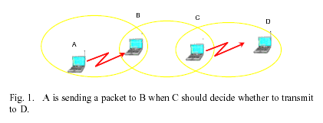
Basic Scenario

Slide 64
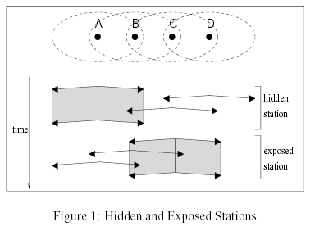
Hidden and Exposed Stations

Slide 65
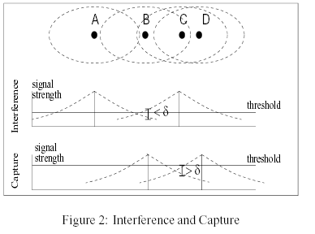
Capture Effect/Near Far Problem

Slide 66
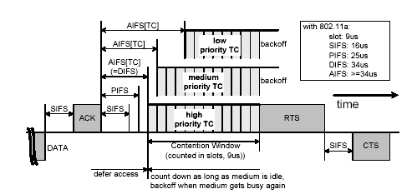
802.11 E

Slide 67
802.11
DIFS
Src
RTS
Data
SIFS
SIFS
Dest
CTS
SIFS
Ack
CW
Other
NAV
(RTS)
Next MPDU
NAV
(CTS)
Defer Access
Backoff after Defer

Slide 68
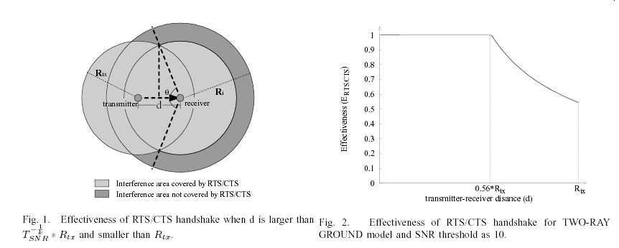
Interference Issue for CSMA/CA

Slide 69
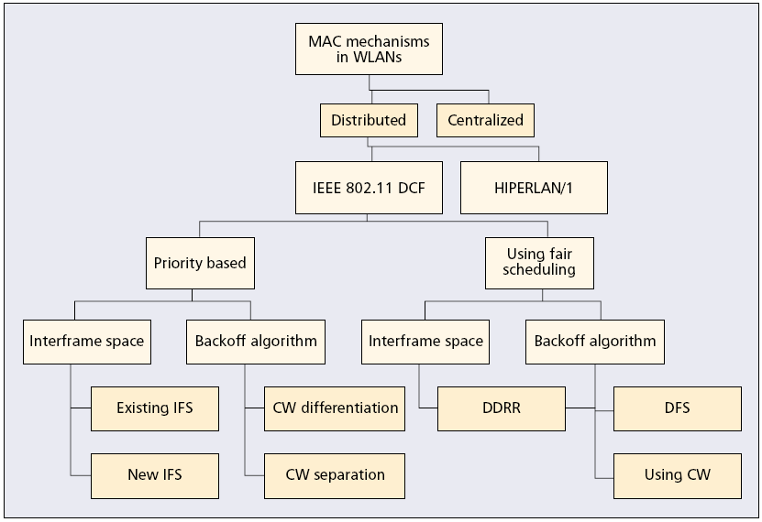
QoS issue for 802.11

Slide 70
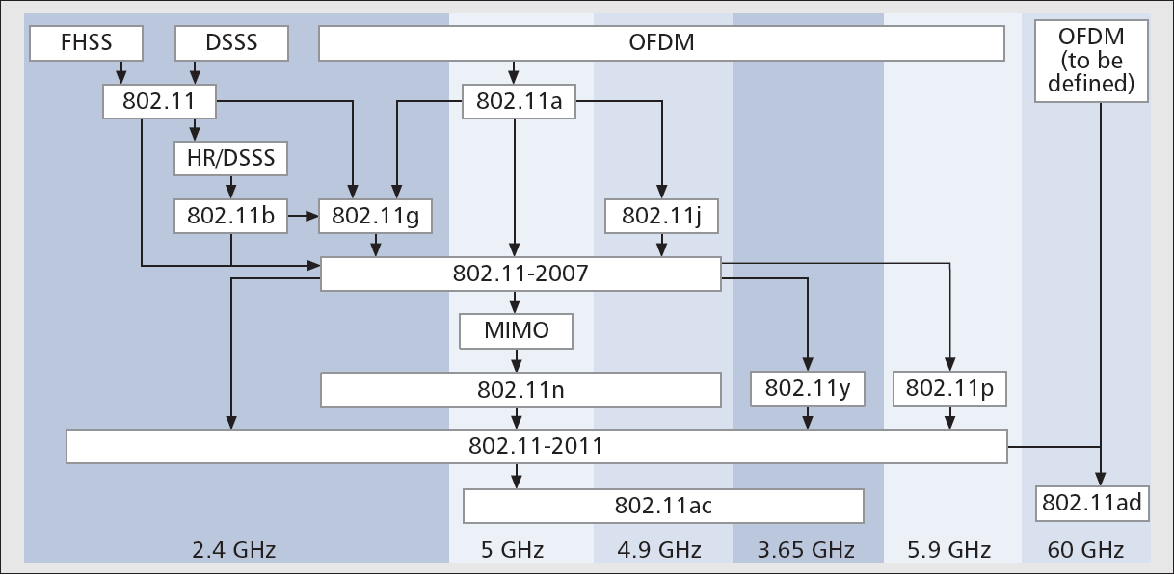
802.11 PHY

Slide 71
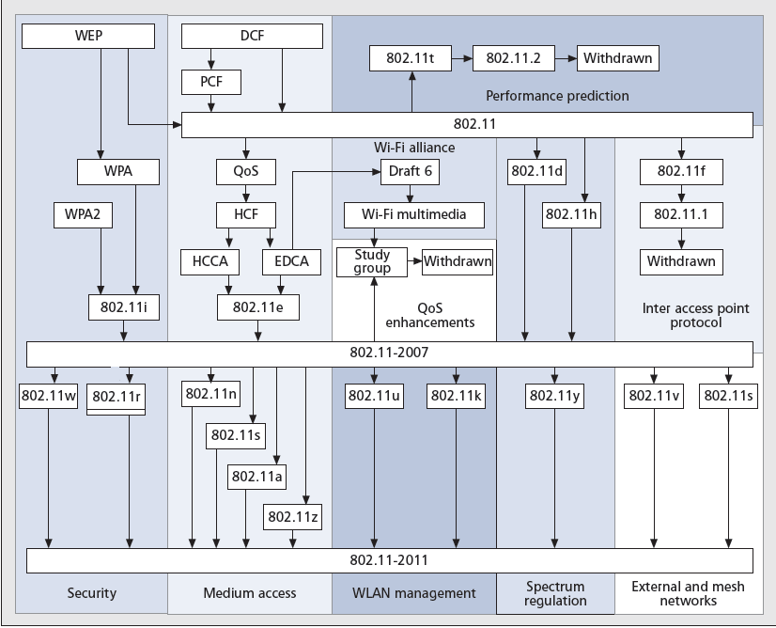
802.11 MAC

Slide 72
Further Issues
QoS (Quality of Services)
  Blackburst
  Backoff
Efficiency
  Dynamic Carrier Sense
  RTS/CTS false blocking issue
Broadcast Protocol
Collision Detection

Slide 73
High-Density (HD) WLAN
In HD-WLAN, its overall capacity can be expressed as .
  L – per link capacity
  C – number of simultaneous trans. Per channel.
  S – the number of non-interfering channels
Hence, the issues of HD-WLAN is
  How to increase the performance of S.
Co-Channel Inference (CCI)

Slide 74
Clear Channel Assessment (CCA)
A station performs CCA before a data trans. to simple the energy in the channel.
The station will proceed only if the sampled energy is below a threshold known as the
CCA threshold.
idle
busy
CCA threshold

Slide 75
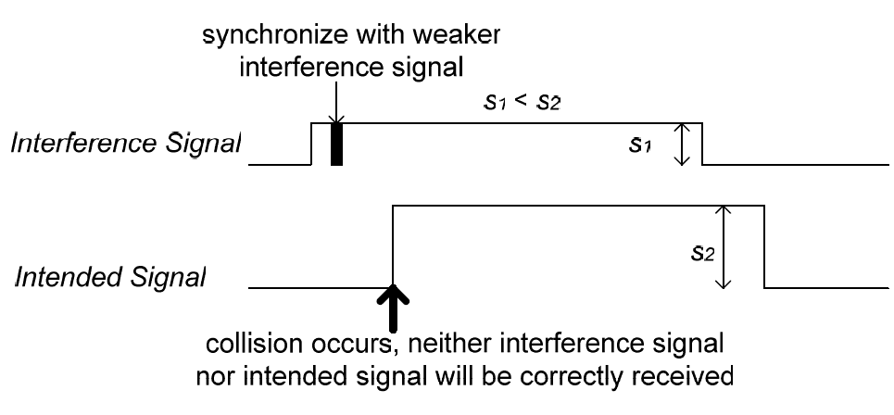
Receiving Sensitivity (RS)
Today’s consumer 802.11 radios are often not a le to preempt a receiving process to capture a newly-arrived strong signal.
This issue called “stronger-last” collision”.

Slide 76
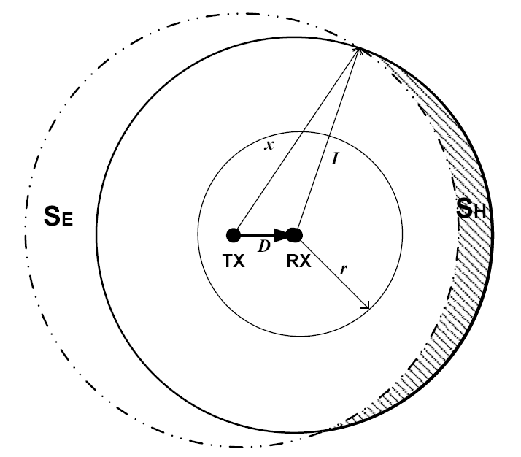
Analytical Model for RS/CCA Adapt.
In 802.11 WLAN research, the logarithm path loss model is widely used to show average SS at receiver.

Slide 77
Only Strong signals triggers Recv.
most of the weak signal that causes strong-last collision will be from device in co-channel cells.
Hence, let be the RS threshold, and RSSI stands for receive signal strength indicator.
However, signal strength is not constant.

Slide 78
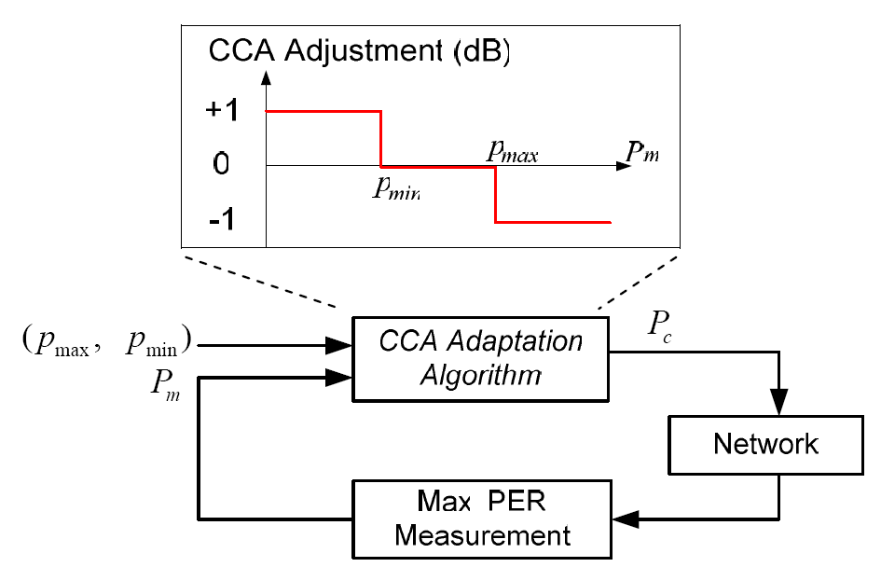
CCA adaptation algorithm
The maximum of measured PER values is used with a simple linear adaptation algorithm.

Slide 79
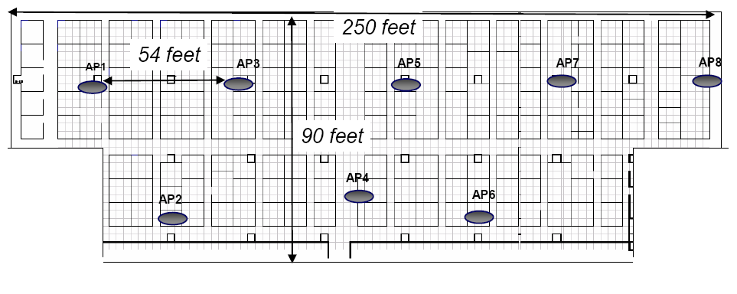
Experimental Topology
Testbed Setup
  8APs, (cisco Aironet 1130 802.11ABG)
  N clients with Centrino 2200 and WAG511(11a)

Slide 80
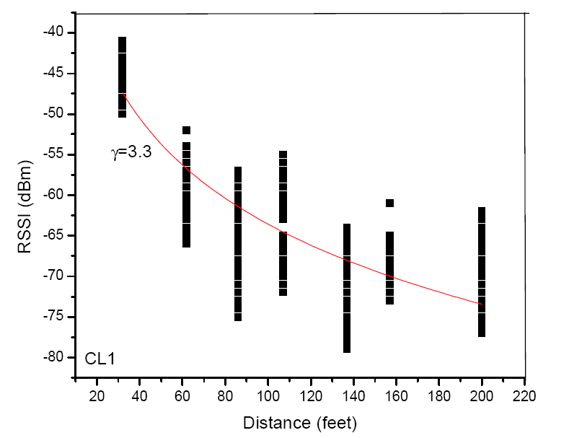
Experimental – Channel Characterization
6 clients are deployed, one in each corner of the network.
HD-WLAN is config.
in 802.11g
channel 1 using
11dbm as
trans. power.
CL: 3.3, 3.9, 3.3,
3.6, 3.9, 3.5.

Slide 81
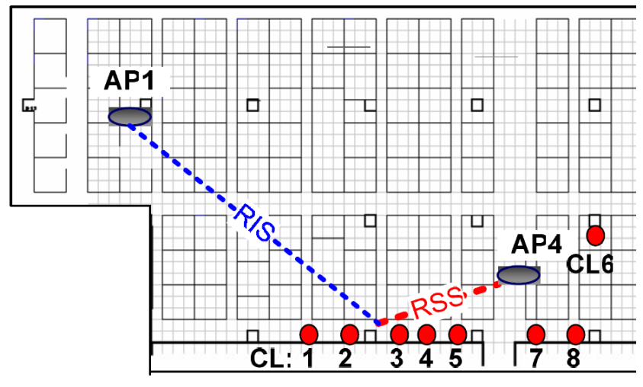
Channel Characterization
Next, CL1-8 are deployed to measure the RSSI between AP1 and AP4.
In each run, CL samples RSSI received from AP1 and AP4 with a 10-second interval from
4000seconds.

Slide 82
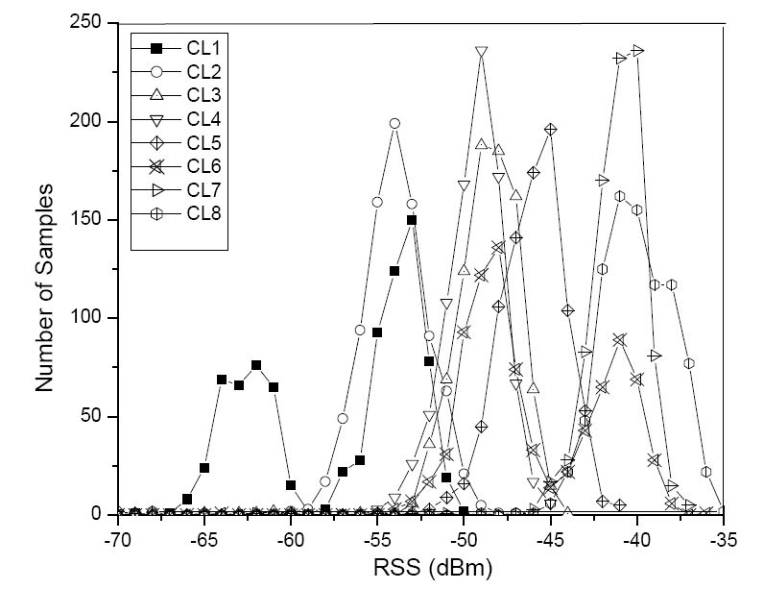
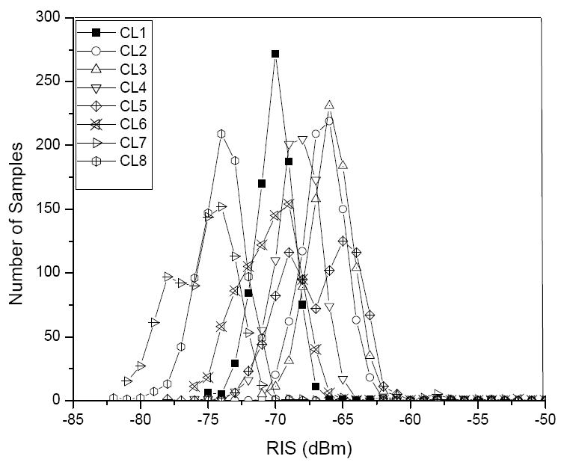
Results of Channel Characterization

Slide 83
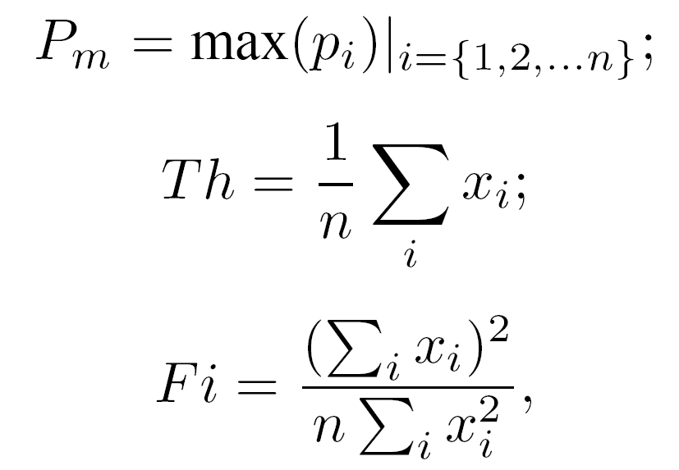
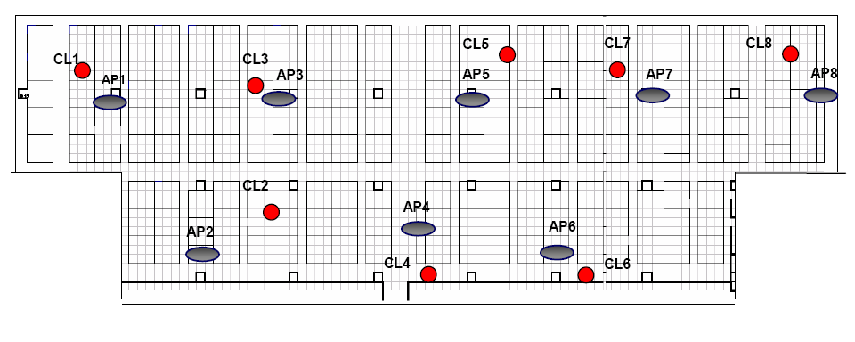
RS Adaptation
Downlink, UDP traffic to
all active CLs with packet
size 1400bytes.

Slide 84
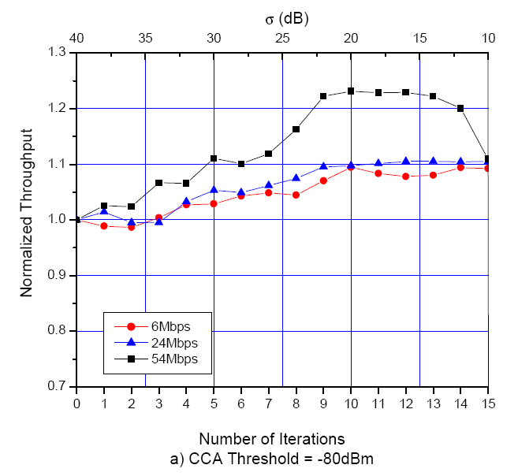
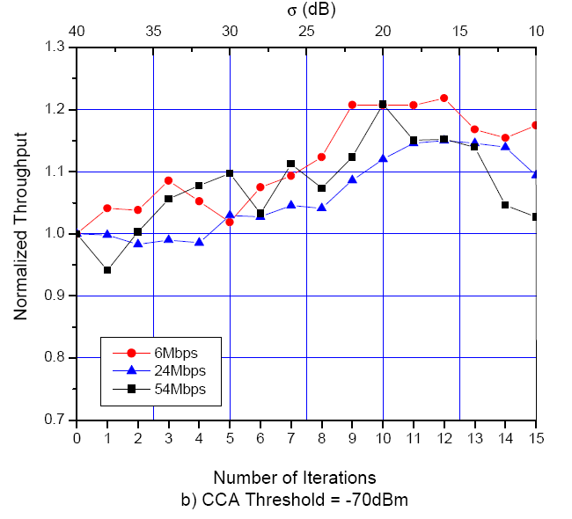
RS Adaptation Results

Slide 85
CCA Adaptation
Next, we investigate the effect of the Pm target with CCA adaptation.
Four targets
  (pmax, pmin) = {(0.2, 0.1), (0.3, 0.2), (0.4, 0.3), (0.5, 0.4)} are tested in sequence
  with total 160 iterations and
  each one staying 40 iterations.

Slide 86
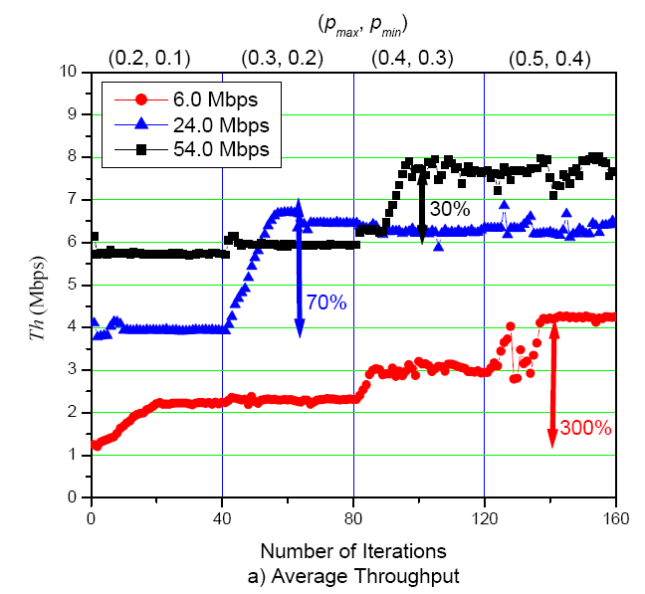
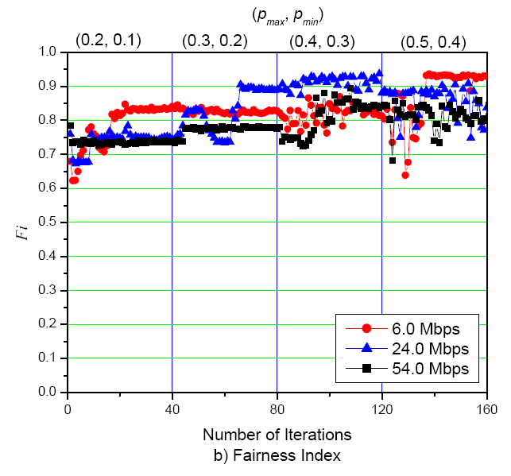
CCA Adaptation results

Slide 87
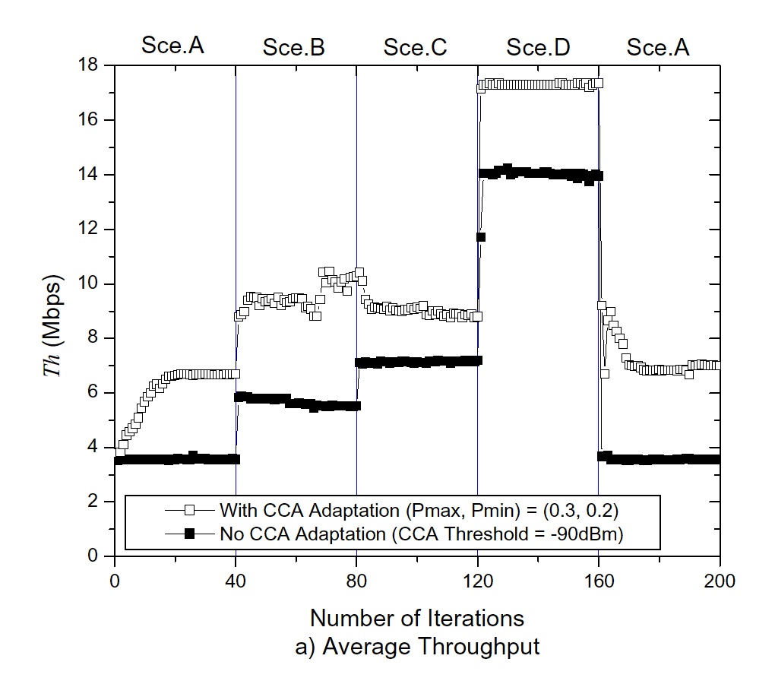
Dynamic CSMA Scheme

Slide 88
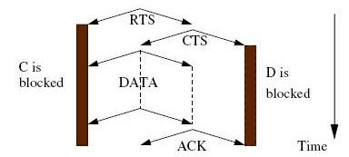
RTS-CTS-Based
RTS-CTS-Based means RTS-CTS-DATA-ACK 4 way handshaking mechanism
RTS (Request-to-Send)
CTS (Clear-to-Send)
ACK (acknowledgement)
NAV (Network Allocation Vector)
DATA
RTS
ACK
blocked
CTS
blocked
C
A
B
D
Defer time
Defer time
Notes:
Though Carrier Sense Multiple Access (CSMA) is simple and scalable, but it causes the hidden and exposed terminal problems.
Then the RTS-CTS-DATA-ACK 4-way handshaking can reduce the hidden terminal problem.
In this figure , node A want to transfer data to node B. So the node A transmit the RTS packet to node B.
Due to the node C hear the RTS from A, node C is blocked itself. Node C’s NAV is updating to defer until data transmitting finish between node A and B.
After node B receives the RTS, if node B is free that it will transmit the CTS to node A.
Then the node D hear the CTS from node B, it is blocked itself. Node D’s NAV is updating to defer until data transmitting finish between node A and B.
After finishing the data transmitting between node A and B, node A will transmit the ACK to node B to ensure that the data transmitting is correctly.
88

Slide 89
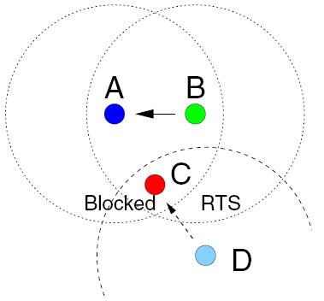
Blocking
Node C is blocked due to the communication between node A and node B.
Node D does not get any response to the RTS packets it sends and enters backoff.
Due to node C neither a hidden node nor an exposed node, so this paper call the problem is blocking problem.
Enter backoff
Notes:
;======= describes the blocking problem =========================================
In this figure, node B transmits a packet to node A.
Node C hears both RTS and CTS packets and , therefore, remains prohibited from transmitting.
When the communication between node B and node A is going on, node D sends an RTS packet to node C.
Since node C is blocked, it can not respond with a CTS.
Therefore, node D does not get any response and enters backoff.
;========================================================================
89

Slide 90
False Blocking(1)
For short, an RTS packet, destined to a blocked node, forces every other node that receives the RTS to inhibit itself even though the blocked destination does not respond, and thus, no DATA packet transmission takes place. We call this problem the false blocking problem.
Because D and F are not really transmitting data.
A
B
C
Blocked
RTS
E
D
F
RTS
Blocked
G
Blocked
False Blocking
Notes:
90

Slide 91
False Blocking(2)
False blocking, however, may propagate through the network, one node may become false blocked due to a node that itself is false blocked.
False blocking may affect the network performance seriously due to unnecessary block.
The worst case of the false blocking will decrease the throughput down to zero. This paper call the worst case “Pseudo Deadlock”.

Slide 92
Pseudo Deadlock(1)
transmission over
G
F
A
DATA
ACK
enter backoff
A
RTS
blocked
DATA
Enter backoff
RTS
RTS
B
blocked
blocked depends
on node A
next RTS
also no reply
blocked depends
on node C.
NAV is extended.
enter backoff
C
RTS
RTS
E
B
Enter backoff
Enter backoff
D
C
D
blocked
RTS
blocked
enter backoff
E
RTS
Enter backoff
RTS
Enter backoff
F
blocked
blocked
Into the cycle
Notes:
In this figure, node A initially receives a packet from node G.
Node F is blocked during this time because node A is receiving.
Therefore, node E does not get any response to the RTS packets it sends to node F.
Node E`s RTS packets, however, force node D into false blocking.
Subsequently, node C does not get any response to the RTS packets sent to node D and, therefore, goes into a deferral period.
Node B, however, receives nod C`s RTS packets and, therefore, gets blocked.
Now, node A, after receiving the packet from node G, wishes to communicate to node B, but when node A sends an RTS to node B,
Node B is already blocked, and therefore, node A does not get any response.
Node A`s RTS blocks node F, though.
Therefore, when node E sends its next RTS, it again receives no reply.
At this moment, in the cycle {A,B,C,D,E,F,A}, every second node {A,C,E}
92

Slide 93
Reliable Broadcast
MAC Reliable broadcast in ad-hoc networks, K. Tang and M. Gerla
MILCOM, Oct 2001
Broadcast Medium Window protocol
Reliably transmit each packet to each neighbor in a round robin fashion through RTS/CTS exchange
Neighbor list is updated on reception of any of (RTS/CTS/DATA/ACK/HELLO) frames.
Each node maintains 3 buffers :
    Input buffer
    Send buffer
    Receive buffer

Slide 94
Reliable Broadcast
Receive Buffer
C
0
CTS Seq:0
Receive Buffer
Receive Buffer
RTS Seq:0-0
Node :B
0
0
B
D
DATA
A
Send Buffer
ACK
0 | 1 | 2 | 3 | 4 | 5
Neighbor list
Receive Buffer
B | C | D | E
0
E

Slide 95
Reliable Broadcast
Receive Buffer
0 | 1 | 2
3
C
Receive Buffer
0 | 1 | 2 | 3 | 4 | 5
Send Buffer
0 | 1 | 2
3
A
B | C | D | E
Neighbor list
B
D
Receive Buffer
0 | 1 | 2
DATA (seq no:3)
DATA (seq no:1)
3
CTS Seq:1
CTS Seq:3
RTS Seq:0-3
Node :E
RTS Seq:0-3
Node :E
ACK
ACK
In case a node has no knowledge of neighbors ,unreliable broadcasting is done using CSMA/CA until neighbors are detected.
Receive Buffer
0 | 2
1
3
E

Slide 96
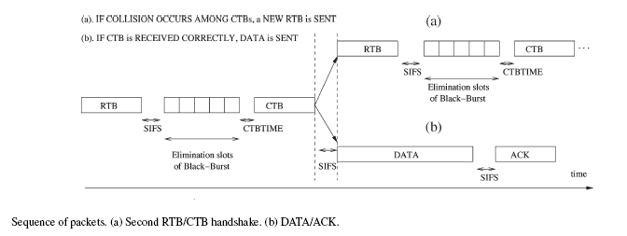
Directional Broadcast

Slide 97
Directional Broadcast
The length of black-burst for ith iteration :
Li= ⎣ (d-L_{i-1}^{longest} .W _{i-1}).N_{max} / W _{i-1}⎦ . SlotTime
i=2,3,...,d_{max}
W_{i} :segment width in ith iteration
L_{i} ^{longest} : length of the longest black burst in ith iteration.
Fast decrease in segment width:
Few nodes
Few iterations.
40m
4m
Source
40m

Slide 98
Directional Broadcast
Random Collision Resolution Phase
Failure of collision resolution phase – start random phase
Random black burst lengths are chosen from [0, N_{max}-1] slots.
This phase continues
    until successful CTB or
    until a maximum no of random iterations
More probability of success
    Because of short stripped segment at the start of random phase
No Black-Burst Response
Assumes loss of RTB packet
Retransmits RTB after a random amount of time.

Slide 99
Directional Broadcast
Transmission of DATA and ACK
2. Successful reception
-collision resolution phase is over
-A sends broadcast packet
A (Source)
E
4.Reception of ACK
-Reliable broadcast
No ACK after timeout
-Random backoff
1. E sends CTB.
3. E sends ACK

Slide 100
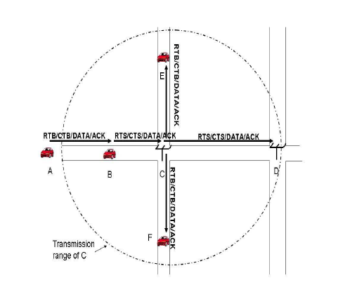
Intersection Broadcast
UMB Protocol

Slide 101
Intersection Broadcast
Fully Ad-Hoc intersection Handling
(AMB protocol)
Define an intersection region of radius R with intersection as the centre.
Selects a Hunter vehicle inside the intersection region.
Select a vehicle for branching the Packet Dissemination
  Hunter vehicle sends I-RTB (Intersection-RTB)
  Vehicle closest to the intersection sends the longest black-burst

Slide 102
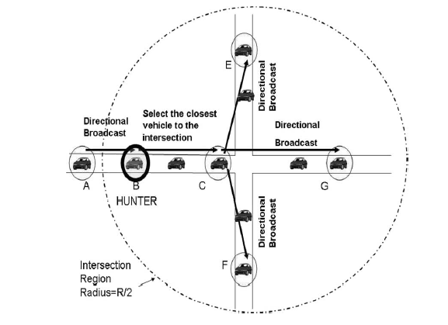
Intersection Broadcast

Slide 103
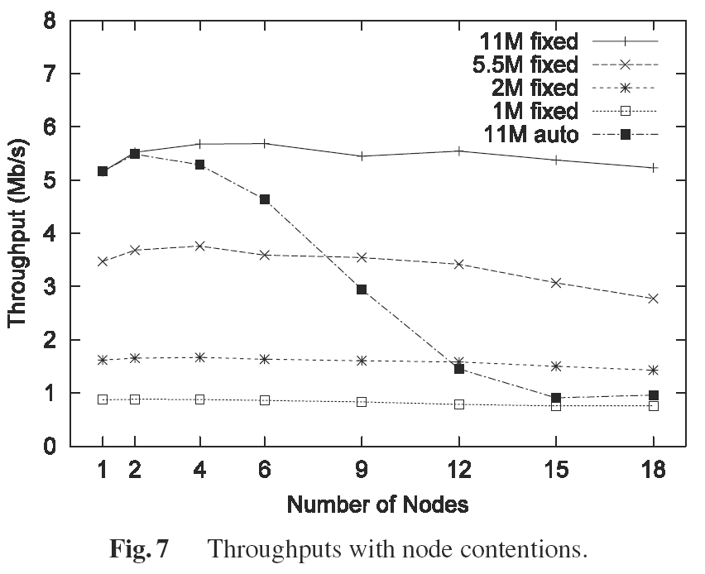
Node Contention
without RTS/CTS
[Choi, ACM SIGMETRICS’05]

Slide 104
Collision Aware Rate Adaptation (CARA)
Employs two methods for identifying collisions:
  1. RTS Probing
  2. Clear Channel Assessment (CCA)
Focuses on when to decrease the transmission rate.
  Set M_{th} , the consecutive increase threshold, to the same value as ARF:
  M_{th} = 10.

Slide 105
CARA RTS Probing
Assumes all RTS transmission failures are due to collisions.
Transmission failure after RTS/CTS must be due to channel errors.
RTS probing that enables an RTS/CTS exchange ONLY when a data frame transmission fails.

Slide 106
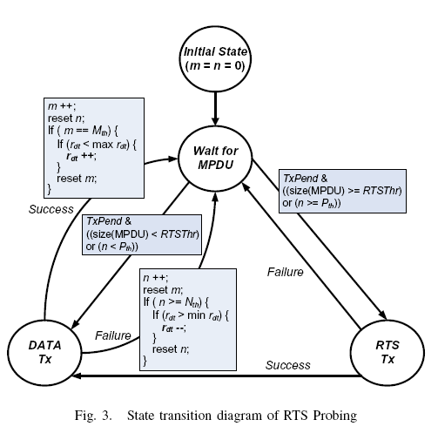
RTS Probing State Diagram

Slide 107
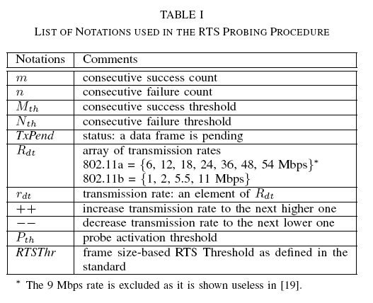
RTS Probing

Slide 108
RTS Probing
CARA default: [P_{th} = 1, N_{th} = 2]
Data frame transmitted without RTS/CTS.
If the transmission fails, RTS/CTS exchange is activated for the next retransmission. If this retransmission fails, then the rate is lowered.
If retransmission is successful, stay at same rate and send next frame without RTS/CTS.

Slide 109
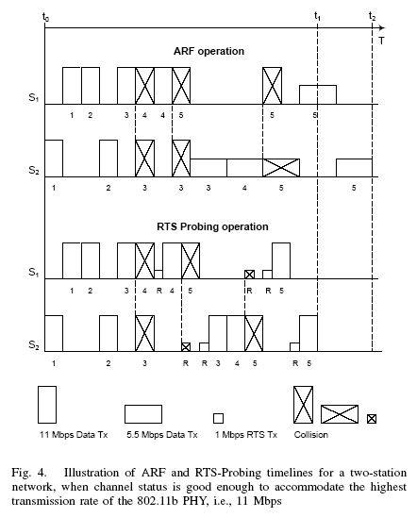
ARF vs RTS Probing
t₁ < t₂

Slide 110
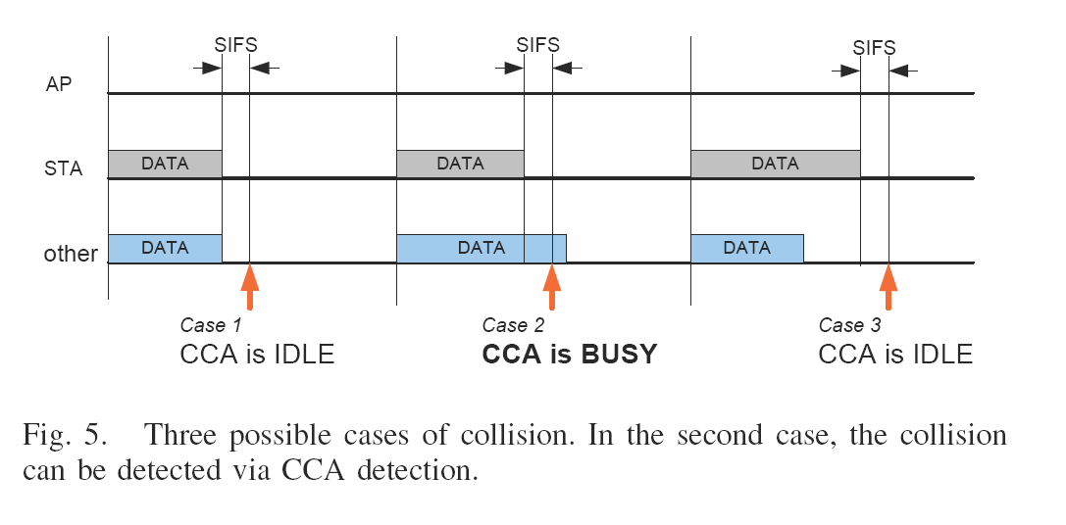
CCA Detection
This assumes no hidden terminals!
*In this case [Case 2], retransmit without increasing the failure count and without lowering the transmission rate.
*CCA does not help for Case 1 or Case 3.

Slide 111
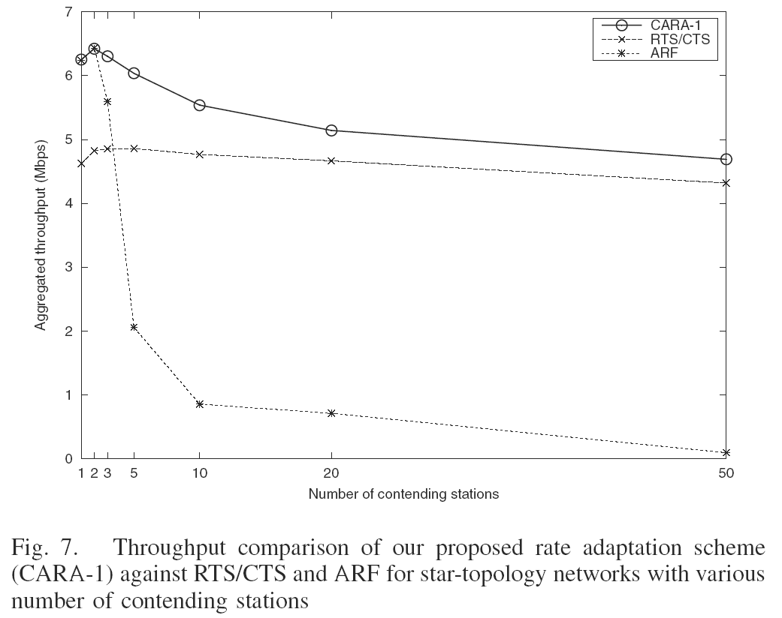
CARA-1 (with RTS Probing)
Contention is harmful to
ARF without RTS/CTS

