Slide 1

Radio Propagation: Issues & Models Dr. Eric Hsiaokuang Wu http://wmlab.csie.ncu.tw
無線網路多媒體系統
Wireless Multimedia System

Slide 2
Lecture II Agenda
Radio Propagation
Physical of radio propagation
Two types of propagation models
Outdoor vs. Indoor Radio Propagation Model
How to do simple “ link budget” calculation
Combating the radio channel impairment
Wireless Modem Design
Modern Application: 911 services

Slide 3
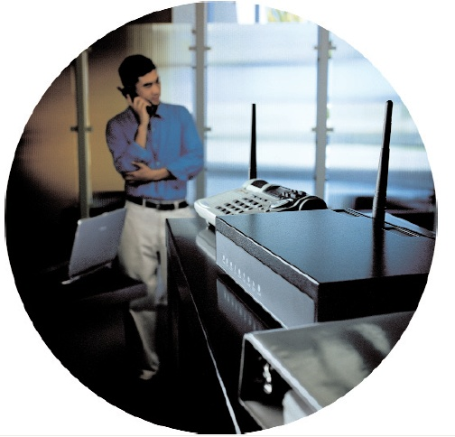

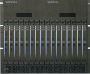
Path Loss Model (Large Scale)
Telco Core Network or Private (Fiber) Network
d0
INTERNET
BACKBONE
d

Slide 4
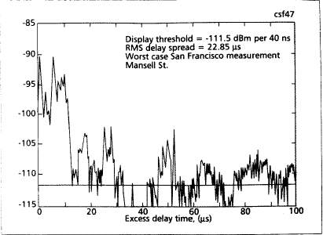
Multi-path fading (Small Scale)
Telco Core Network or Private (Fiber) Network
INTERNET
BACKBONE

Slide 5
Reading list for This Lecture
Required Reading:
(Jorgen95) J. B. Andersen, T. S. Rappaport, “Propagation Measurements and Models for Wireless Communications channels”, (IEEE Communication Magazine), pp. 42~49
(Jeffrey H98) Jeffrey H. Reed, Kevin J. Krizman, Brian D. Woerner, and T. S. Rappaport, “An Overview of the Challenges and Progress in Meeting the E-911 Requirement for Location Service, (IEEE Communication Magazine), pp.30~37
Further Reading
(Rappaport97) T. S. Rappaport, K. Blankenship, H. Xu, “Propagation and Radio System Design Issues in Mobile Radio Systems for the GloMo Project

Slide 6
The mystery of the Radio Propagation

Slide 7
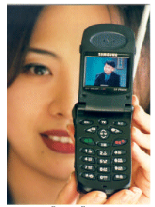

How to deal with Radio Propagation
IP backbone

Slide 8
Where are you from?

Slide 9
QoS and Multimedia Traffic Support
Application
OS, MiddleWare
RTP, TCP, UDP
Adaptive
Algorithm
by QoS
Requirement
RSVP
Mobility
Unpredictable
channel
by QoS
Information
IP, Mobile IP
Wireless Network Layer
Clustering(optional)
Data Link
MAC
Radio

Slide 10
Simplified View of a Digital Radio Link
Source
Coder
Multiplex
Multiple
Access
Channel
Coder
Modulator
Power
Amplifier
Source
Coder
Carrier f_{c}
“Limited b/w”
“Highly variable b/w”
“Random & Noisy”
“Spurious Disconnections”
Radio
Channel
Source
Coder
Demultiplex
Multiple
Access
Channel
Decoder
Demodulator
& Equalizer
RF
Filter
Source
Coder
Carrier f_{c}

Slide 11
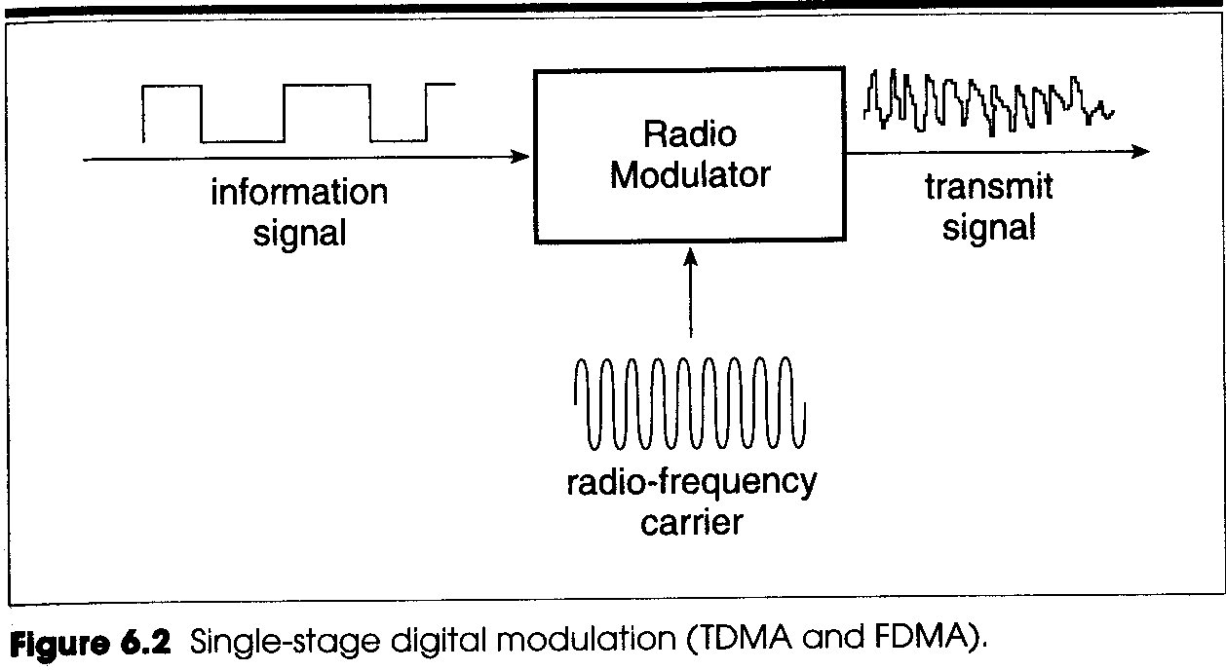
Digital to Analog Modulation

Slide 12
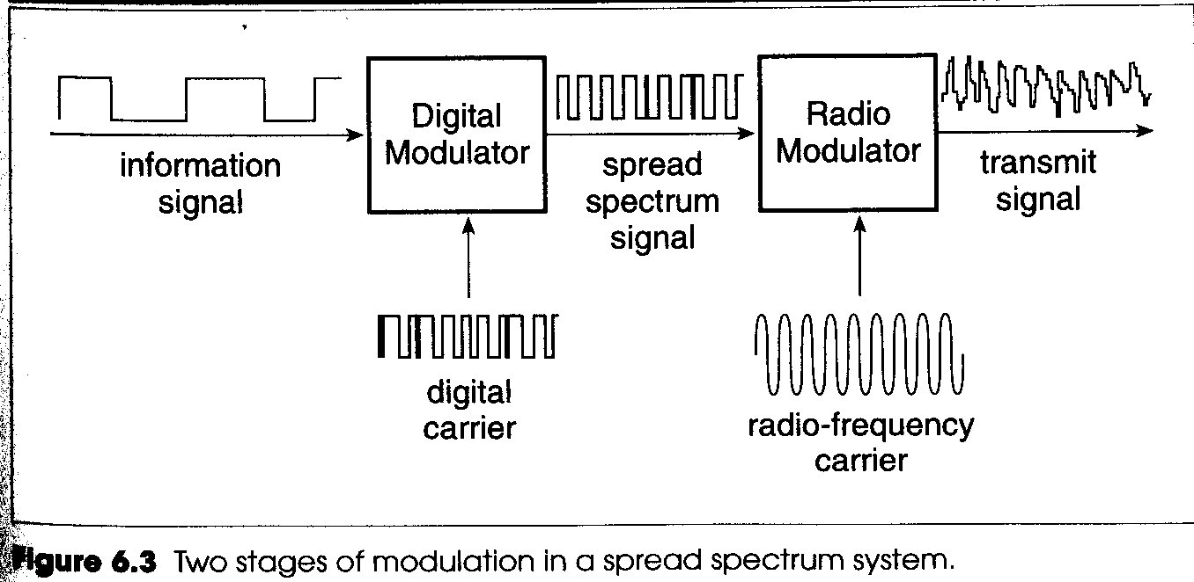
Digital-Digital-Analog Modulation

Slide 13
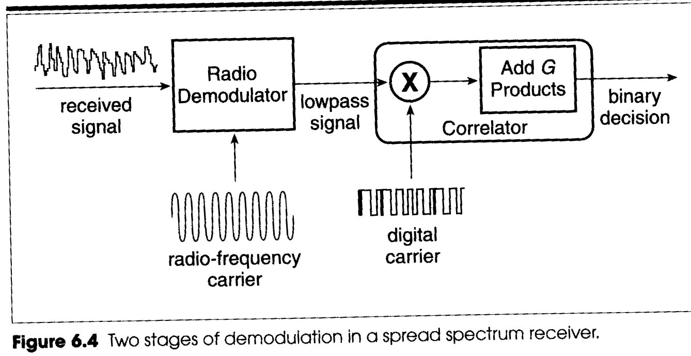
Digital Correlator

Slide 14
Multiple correlators
Multiple correlators in each receiver
At any instant of time, the signal carriers in the different correlators are synchronize to signal paths with different propagation times
A search circuit examines the arriving signal in order to detect the appearance of a new path, then assign a correlator to synchronize the signal on the path

Slide 15
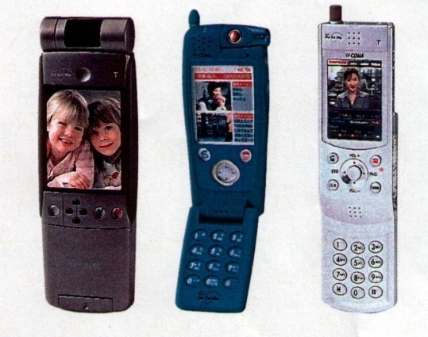
Key role for the radio propagation
Radio Propagation determines
the area which could be covered
The maximum data rate in a system
Battery power requirement for mobile transceivers

Slide 16
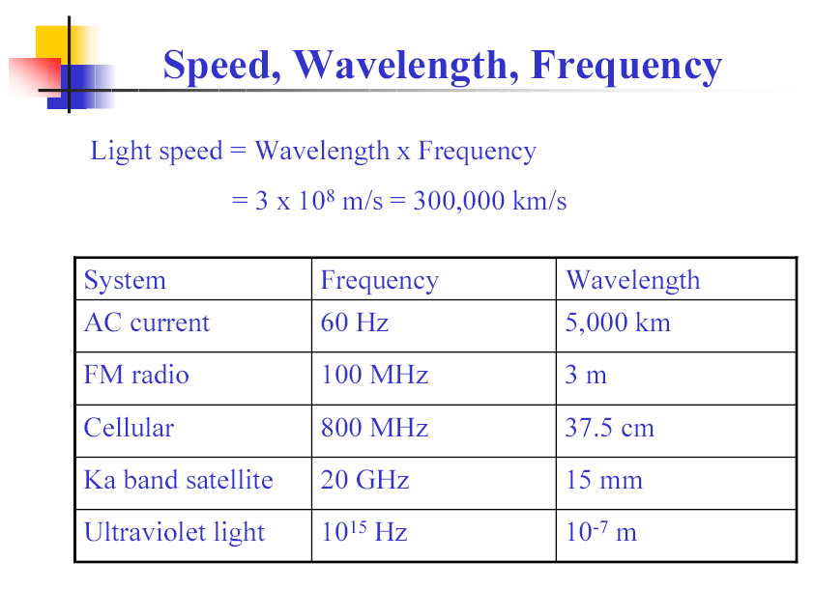

Slide 17
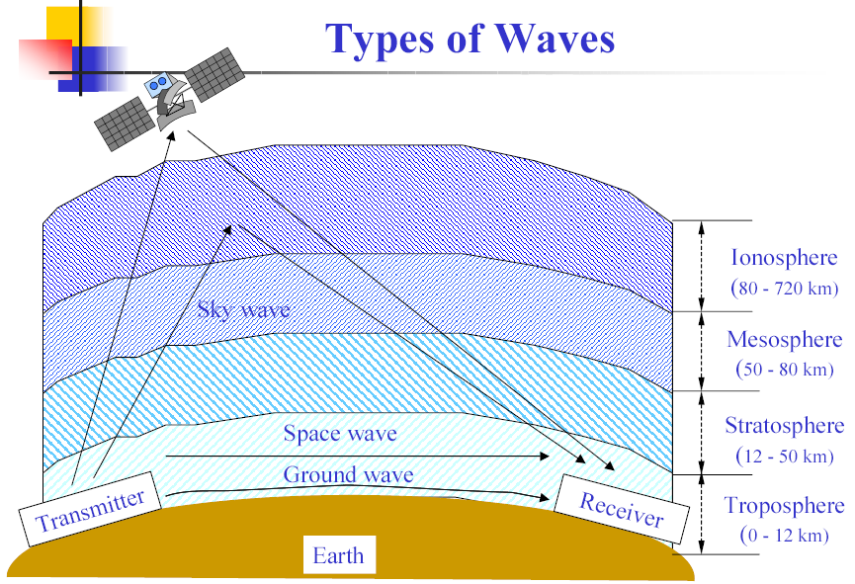

Slide 18
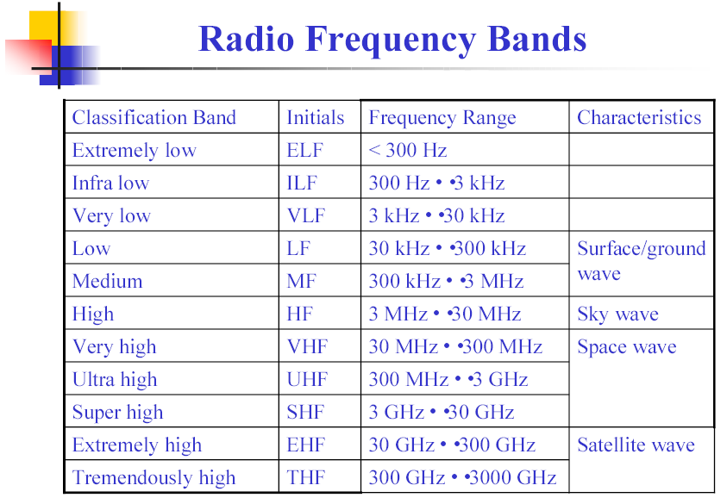

Slide 19
Radio Channel
Free Space
Land Mobile
Multi-path Propagation
Shadow

Slide 20
Some Distributions
Normal (Gaussian)
Log-normal Distribution
Rayleigh Distribution
Rician Distribution
Dominant path
Impulse Response

Slide 21
Propagation Mechanisms in Space with Objects
Reflection (with Transmittance and Absorption)
Radio wave impinges on an object
Surface of earth, walls, buildings, atmospheric layers
If perfect (lossless) dielectric object, then zero absorption
If perfect conductor, then 100%reflection
Diffraction
Radio path is obstructed by an impenetrable surface with sharp irregularities (edges)
Secondary waves “bend” around the obstacle (Huygen’s principle)
Explain how RF energy can travel without LOS
“shadowing
Scattering (diffusion)
Similar principles as diffraction, energy reradiated in many directions

Slide 22
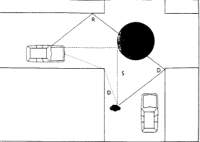
Reflection, Diffraction, and Scattering in Real-Life
Received signal often a sum of contributions from different directions
Random phases make the sum behave as noise (Rayleigh Fading)

Slide 23
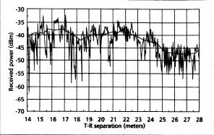
Small-scale and Large-scale Fading
Signal fades rapidly as receiver moves, but the local average signal changes much more slowly

Slide 24
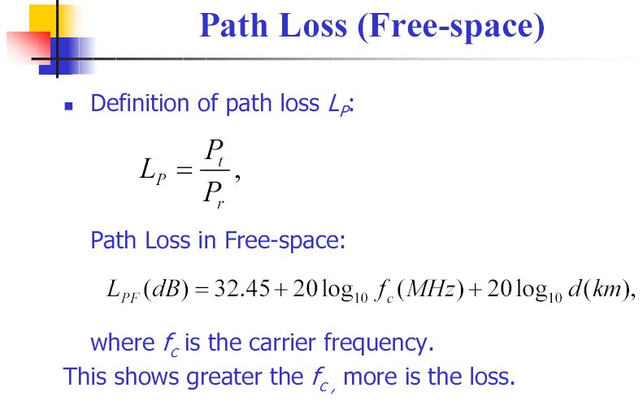

Slide 25
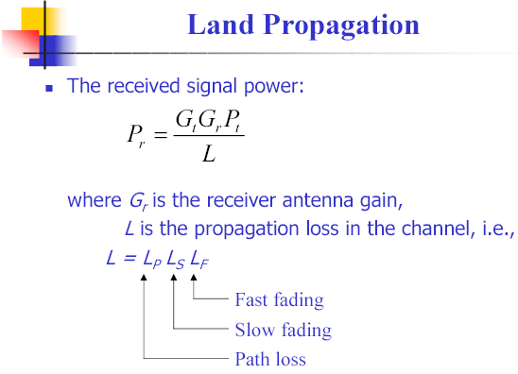

Slide 26
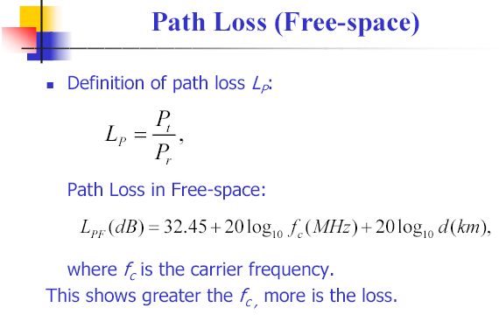

Slide 27
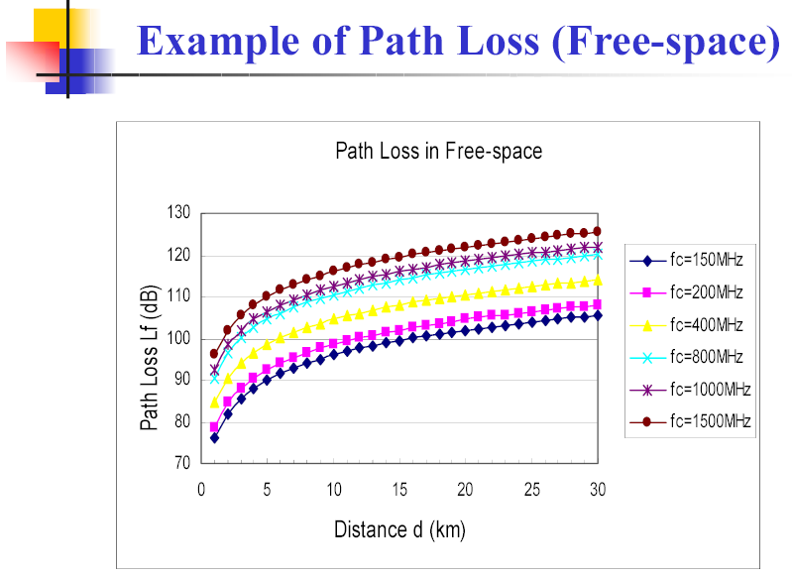

Slide 28
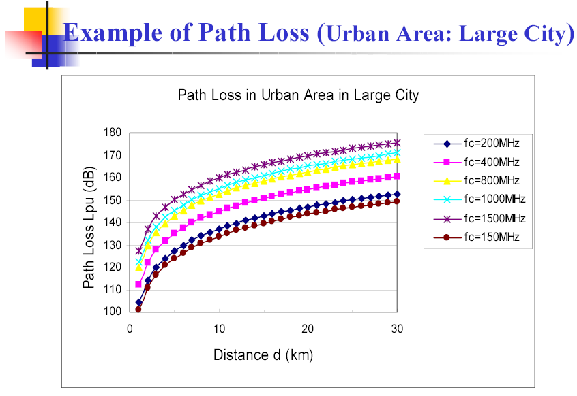

Slide 29
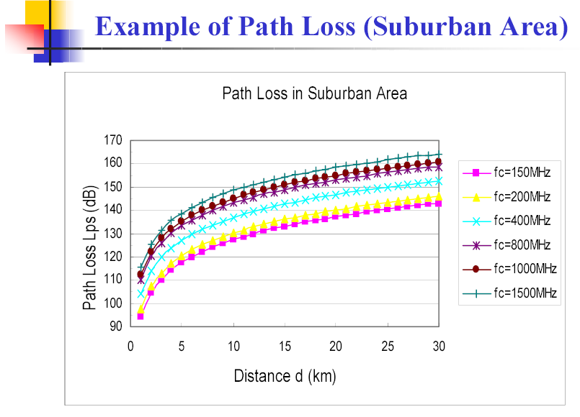

Slide 30
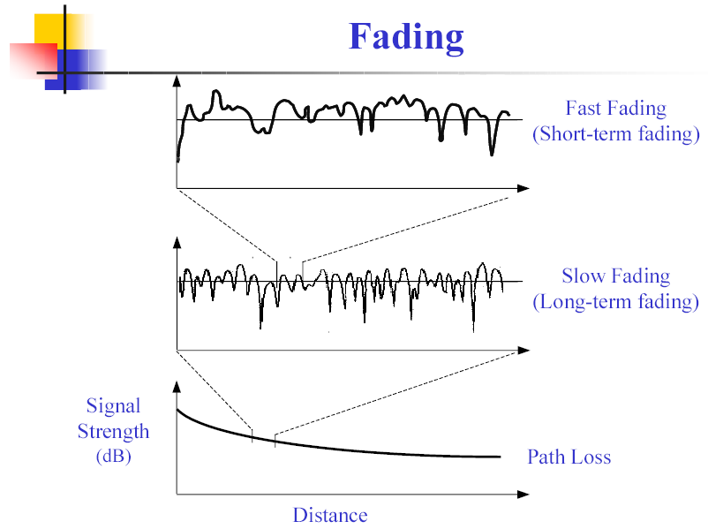

Slide 31
Analysis of the Propagation
Large Scale Effect
The variation of the mean received signal strength over large distance or long time intervals
Small Scale Effect
The fluctuations of the received signal strength about a local mean, where these fluctuations occur over small distances or short time interval

Slide 32
Large Scale -> Link Budget

Slide 33
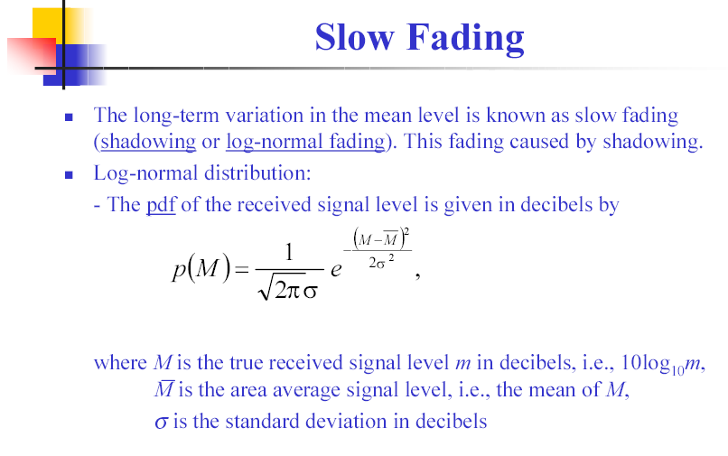

Slide 34
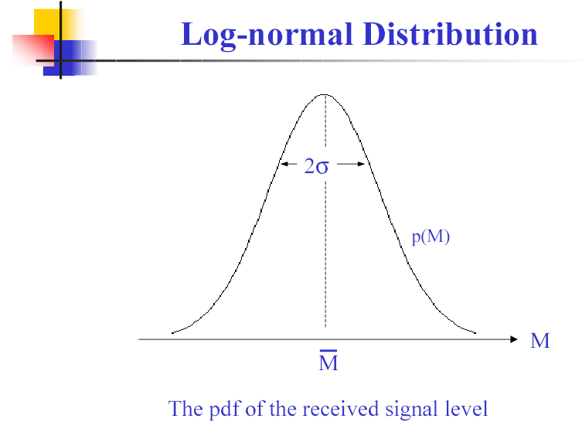

Slide 35
Free Space Propagation Model
Used when Transmitter and Receiver have a clear, unobstructed, line of sight (LOS) path
e.g. satellite channels, microwave LOS radio links
Free space power at a receiver antenna at a distance d from transmitter antenna is
Path loss = signal attenuation as a positive quantity in dB
where,
G_{t} and G_{r} are antenna gains
L >= 1 is the system loss factor not related to propagation
(e.g. loss due to filter losses, hardware

Slide 36
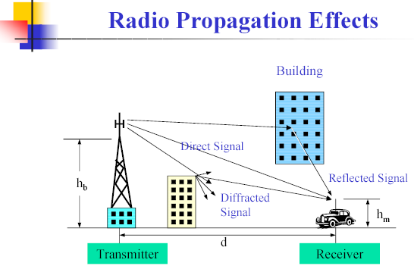

Slide 37
Example: Ground Reflection (2-Ray) Model
T
E_{LOS}
R
Model found a good predictor for large-scale signal strength over distances of several kilometers for mobile systems with tall towers (heights > 50m) as well as for LOS microcell channels
Can show (physics) that for large d
Much more rapid path loss than expected due to free spaces
h_{t}
E_{i}
E_{r}
h_{r}
_{i}
_{r}
d

Slide 38
Log-Distance Path Loss Model
Assume average power (in dB) decreases proportional to log of distance
Justification?
Measurements
Intuition/theory.. Recall; free space, ground-reflection model
Problem: “Environment Clutter” may differ at two locations at the same time (Log-normal Shadowing)

Slide 39
Typical Path Loss Exponent, n
Environment | Path Loss Exponent, n
Free Space | 2
Urban area cellular / PCS | 2.7 to 4.0
Shadow urban cellular / PCS | 3 to 5
In building line of sight | 1.6 to 1.8
Obstructed in building | 4 to 6
Obstructed in factories | 2 to 3

Slide 40
Practical Link Budget Design Using Path Loss Models
Bit-Error-rate is a function of SNR (signal-to-noise ratio), or equivalently CIR (carrier-to-interference ratio), at the receiver
The “function” itself depends on the modulation scheme
Link budget calculations allow one to compute SCR or CIR
Battery Life-> Talk Time -> received/Transmitted power -> Path Loss Models

Slide 41
Example Link Budget Calculation
Maximum separation distance vs. transmitted power (with fixed BW)
Given
Cellular phone with 0.6W transmitted power
Unity gain antenna, 900 MHz carrier frequency
SNR must be at least 25 dB for proper reception
Receiver BW is B=30KHz, noise figure F=10 dB
What will be the maximum distance?
Solution:
N= -174 dBm + 10 log 30000 + 10 dB
For SNR > 25 dB, we must have Pr > (-119+25) = -94 dBm
Pt=0.6W = 27.78 dBm
This allows path loss PL(d) = Pt – Pr < 122 dB
for free space, n=2, d < 33.5 km
for shadowed urban with n=4, d < 5.8 km

Slide 42
Link Budget (SNR)
Frequency
Power
Distance
Environments
Bandwidth

Slide 43
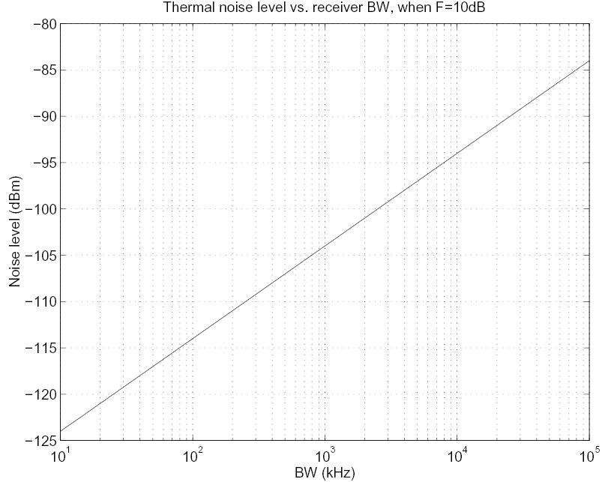
Noise
N=KT₀BF (K=1.38*10⁻²³J/K Boltzmann’s constant, T₀=290K)
N(dBm)=174(dBm)+10log₁₀B+F(dB)

Slide 44
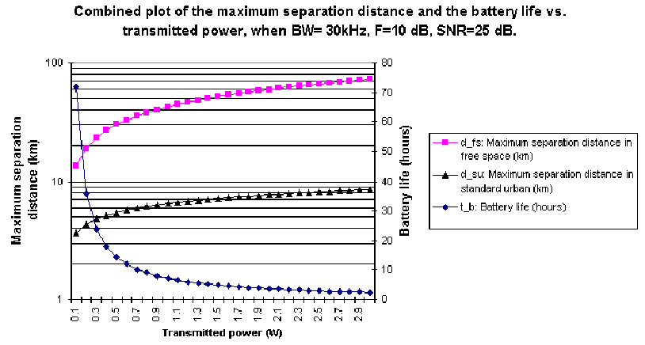
Distance/Power/Battery/Environment

Slide 45
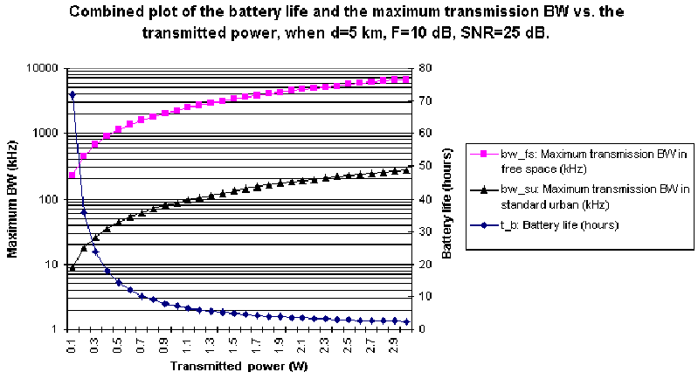
BW/Power/Battery/Environment

Slide 46
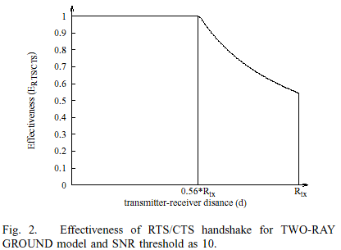
Effectiveness of RTS/CTS handshake in 802.11 Ad hoc Network

Slide 47
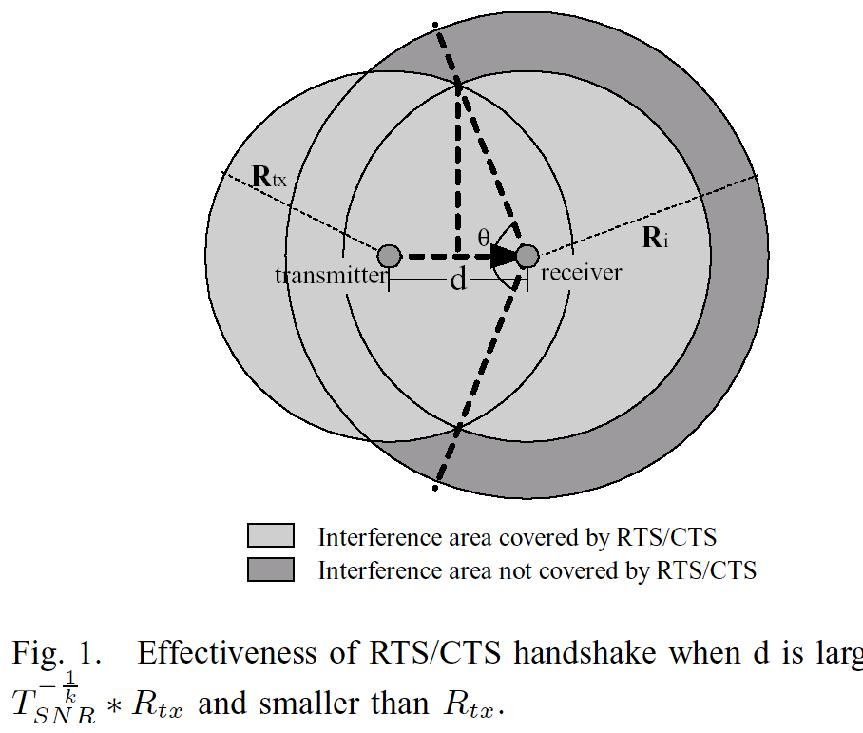
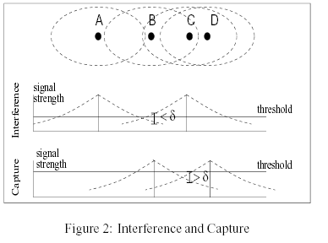
Large Area Interference Problem

Slide 48
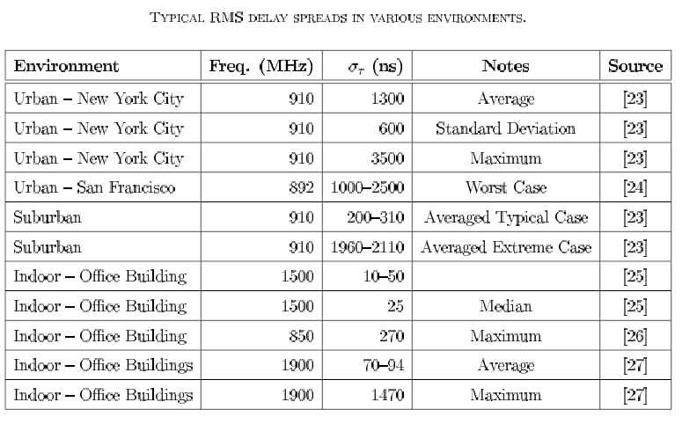
RMS Delay Spreads

Slide 49
Small Scale -> Quality of Service

Slide 50
Small-Scale Fading Effects (over small t and x)
Fading manifests itself in three ways
Time dispersion caused by different delays limits transmission rates
Rapid changes in signal strength over small x or t
Random frequency modulation due to varying Doppler shifts
In urban areas, mobile antenna heights << height of buildings
Usually no LOS from base station
Moving surrounding objects also cause time-varing fading

Slide 51
Factors Influencing Small-Scale Fading
Multi-path propagation
Speed of Mobile
Speed of surrounding objects
Transmission bandwidth of the signal

Slide 52
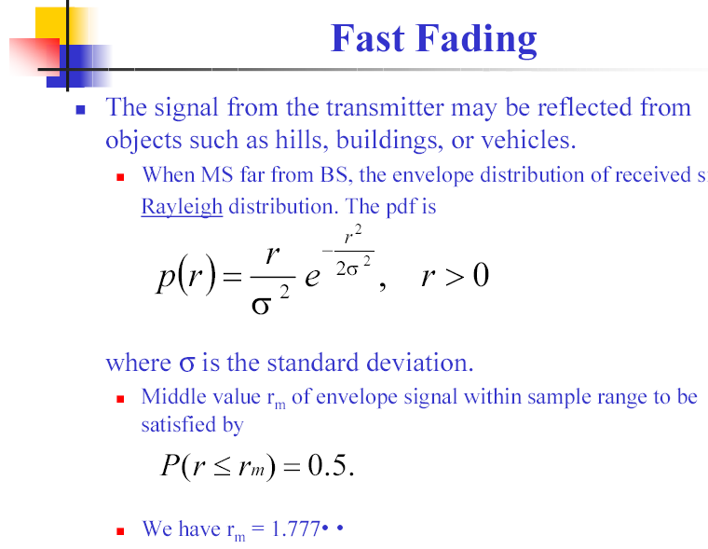

Slide 53
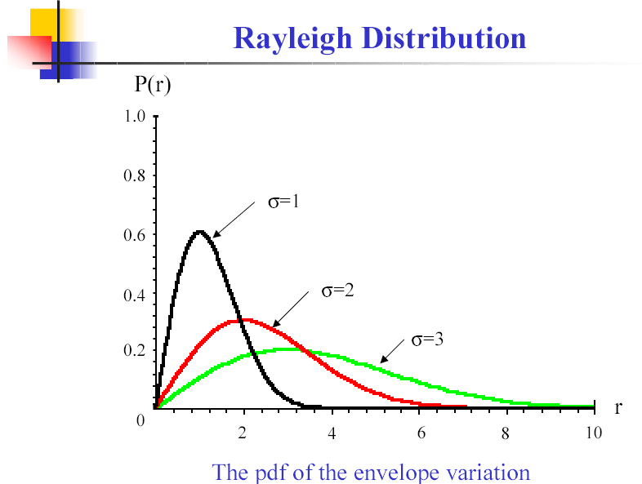

Slide 54
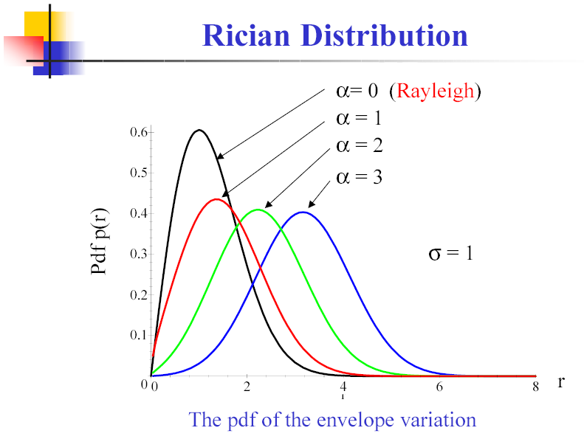

Slide 55
Delay Spread

Slide 56
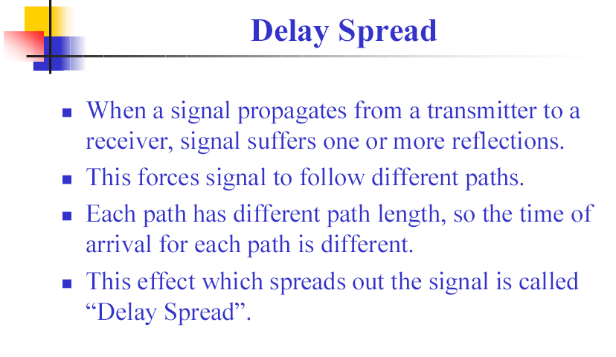

Slide 57
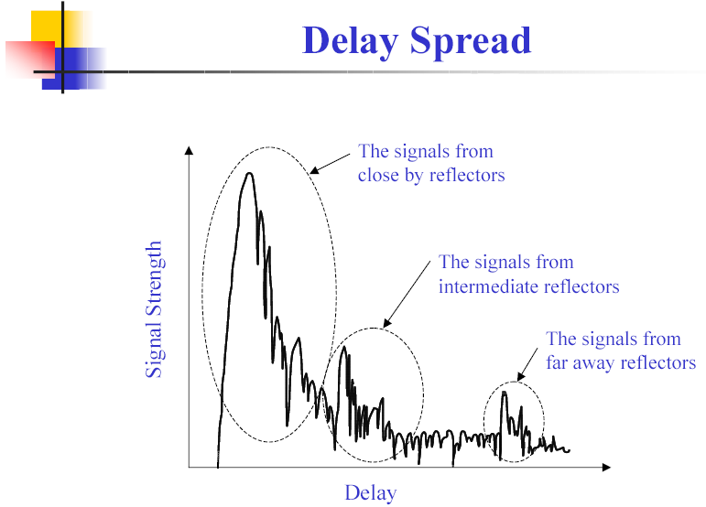

Slide 58
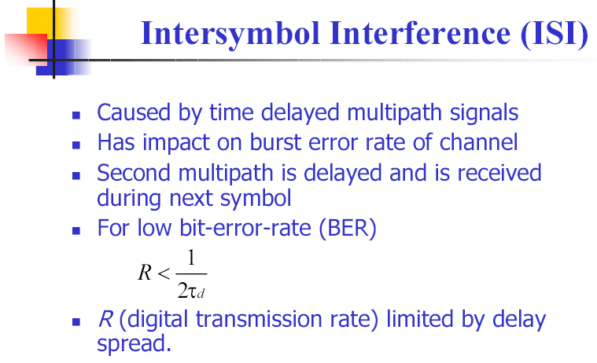

Slide 59
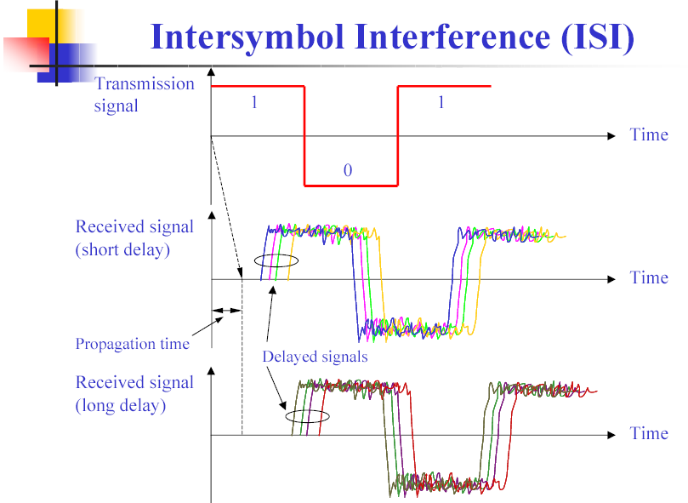

Slide 60
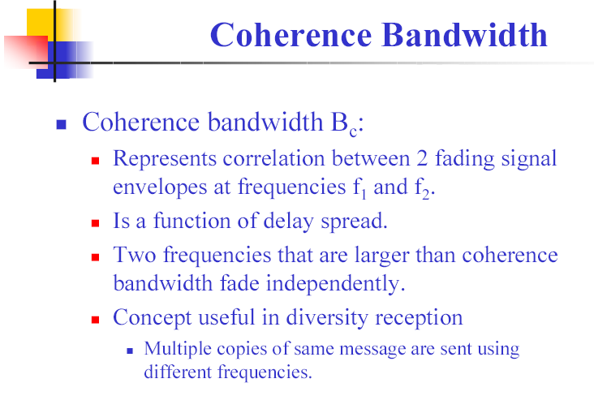

Slide 61
Parameters of a Multipath Channel
Multipath Channel Impulse Response (measured by sounding technique)
Four important parameters of interest
RMS delay spread
Coherence bandwidth
Doppler spread
Coherence time

Slide 62
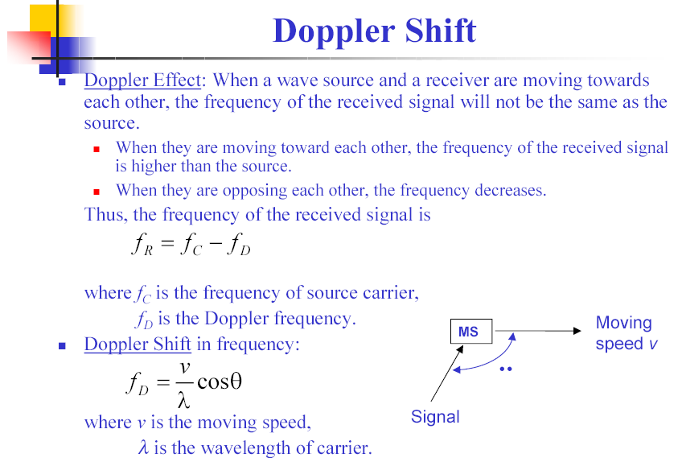

Slide 63
Types of Fading
Two independent mechanisms:
Time Dispersion (Due to Multi-path delays)
Flat fading
Frequency Selective Fading
Doppler Spread (due to Motion of mobile or channel)
Fast Fading
Slow Fading

Slide 64
Fades: Why do we care?
Data Rate
Equalization
Fades result in “Error Bursts”
Average duration of (Flat) fades
Depends primarily on speed of the mobile.

Slide 65
The Design of Wireless Modem

Slide 66
Combating Errors
Increase transmitted power
(Adaptive) Equalization
Antenna or space diversity for “Multipath”
Forward error correction
Automatic Repeat Request (ARQ)

Slide 67
Direct Sequence Spread Spectrum
To transmit a 0 the station use a unique “chip sequence”:
To transmit a 1 the station use the one’s complement of its chip sequence:
1 0 1 1 0
0 1 0 0 1
Therefore if data is 1010 it will transmit:
1
0
1
0

Slide 68
Frequency Hopping Spread Spectrum
Transmitted signal is spread over a wide range of frequencies. (i.e. 2.400-2.485 GHz)
Transmission usually hop 35 times per second.
Freq.
f₇
f₆
f₅
f₄
f₃
f₂
f₁
Time

Slide 69
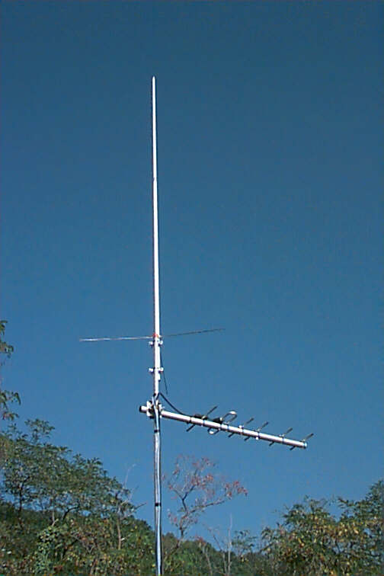
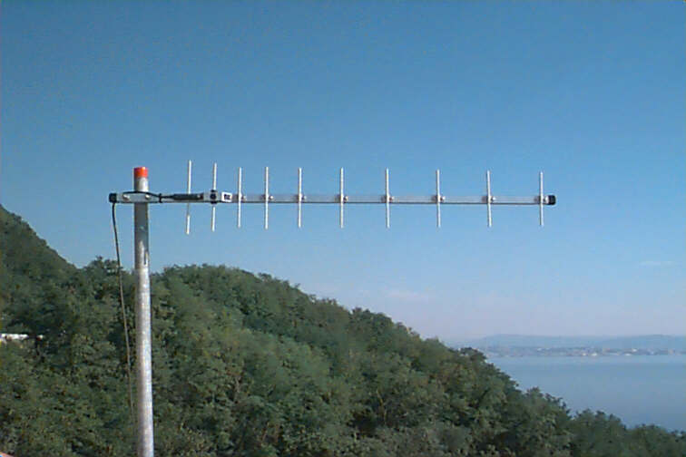
Antenna Types
YAGI Directional Antenna
Omni Directional Antenna

Slide 70
Modern Applications: 911 Service
Location Service

Slide 71
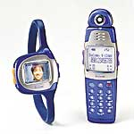
E-911 Requirement for Location Service
1996, FCC (Federal Communications Commission) announced its mandate for enhanced emergency services for cellular phone callers.
The current deadline for this capability is October 1, 2001

Slide 72
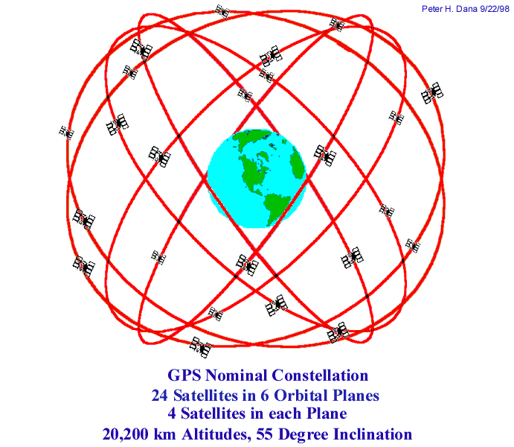

Slide 73
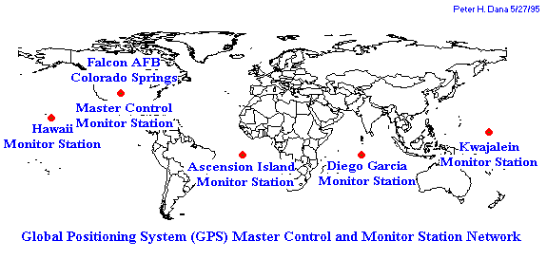

Slide 74
GPS (cont.)
Position location
3-D 座標 (x,y,z) 需要3個獨立方程式可解.
三個GPS衛星得到三個距離量度，可設定所需的三個方程式.
需要第四個衛星來求得另一距離量度以建立第四個方程式 (T_{error})
這樣就可定位出他的位置
With accuracy of approximately 100 m.

Slide 75
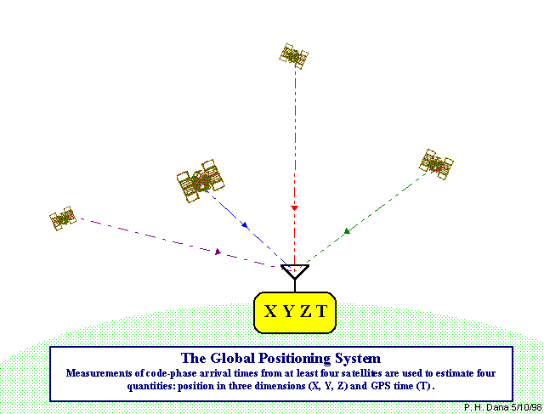

Slide 76
Introduction
Safety is the primary motivation for vehicle position location.
Landline telephone companies to provide 911 emergency service .
1994, begin investigating similar service for U.S cellular and PCS providers.
E-911 service include caller’s ANI and street address information.

Slide 77
Mobile Location Solution
Driving Force :
Legal aspects :
Fire brigades, hospitals and other emergency centers.
Commercial aspects :
Differentiation : new and attractive services.
Reduced costs : operators can adapt their network to match calling patterns.
Increased revenues : commercial services that use positioning information is infinite.
Notes:
Simple explanation. Privacy.

Slide 78
Positioning mechanism and requirement
Terminal-based :
Positioning intelligence is stored in the terminal or its SIM card.
Network-assisted global positioning system (A-GPS).
Network-based :
Positioning intelligence isn’t built into the handset.
Measurement of Cell global identity and timing advance(CGI+TA)、uplink time of arrival (UL-TOA).
Notes:
SIM: Computation Capability and Programming
Time difference / clock and distance

Slide 79
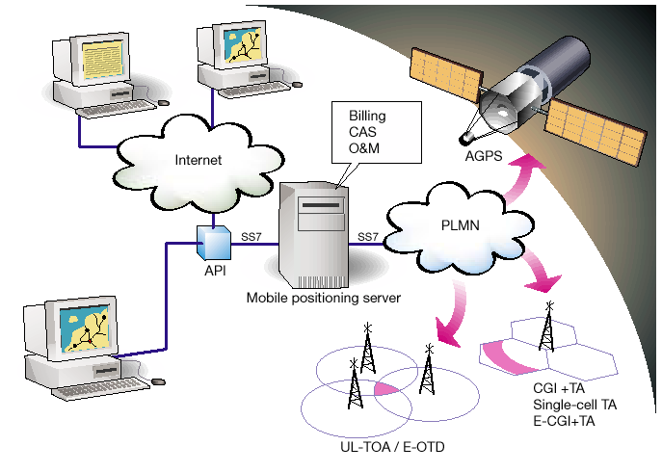
Mobile location solution has been designed to handle a variety of
positioning methods and application interfaces.
Notes:
1. Network and Handset / Postion center

Slide 80
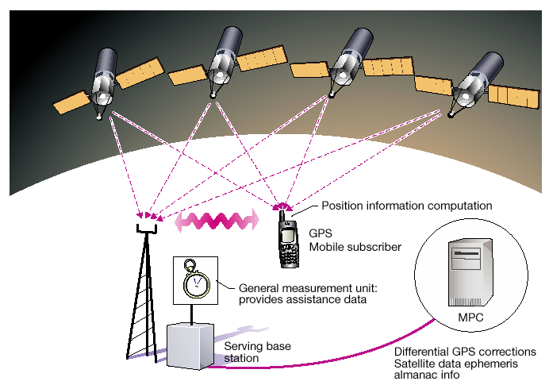
Network-assisted GPS (A-GPS) is a positioning
product with very attractive characteristics.

Slide 81
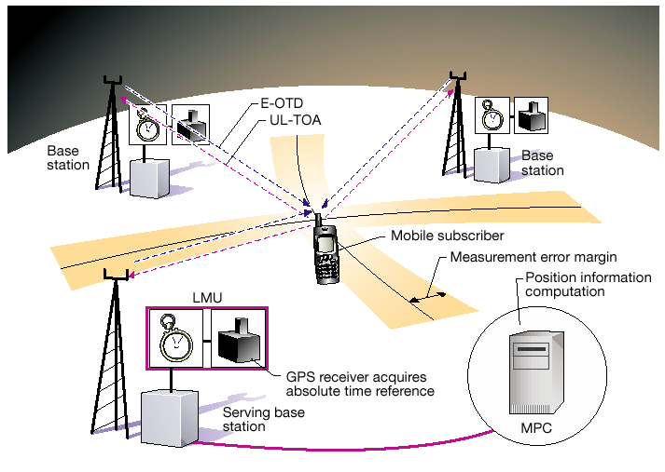
UL-TOA and E-OTD methods each use the triangulation of time difference between base stations and the terminal to determine positions.

Slide 82
Location applications
Information services :
Location-based yellow pages, events, and attractions (ex. What is happening today in town near here?) .
Tracing services :
Tracing of a stolen car, helping paramedics to locate persons quickly in an emergency situation, and giving a towing service or automobile repair shop the location of a motorist in need (out of gas, flat tire, dead battery).

Slide 83
Location applications (cont.)
Resource management :
Taxi fleet management, the administration of container goods, and the assignment and grouping of railway repairmen.
Navigation :
Vehicle or pedestrian navigation.

Slide 84
Small Scale Fading
Mean Excess Delay, rms delay spread
0 dB
-10 dB
-20 dB
-30 dB
0
1
2
5
Ι (μs)

Slide 85
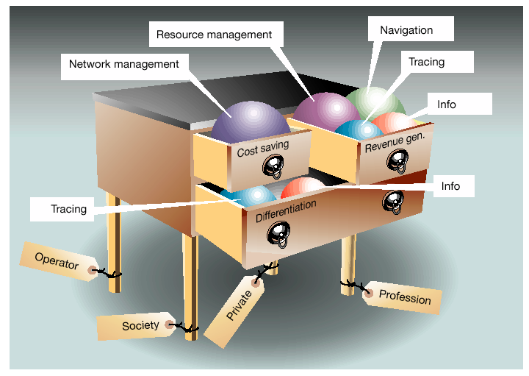
The chest of drawers illustrates how different applications can be grouped strategically for use by their beneficiaries.
Notes:
1. Applications

Slide 86
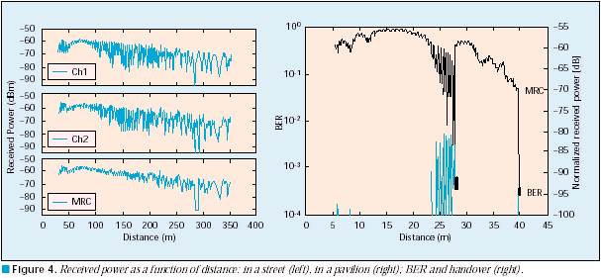
Channel Propagation and Fading

